Slide 1
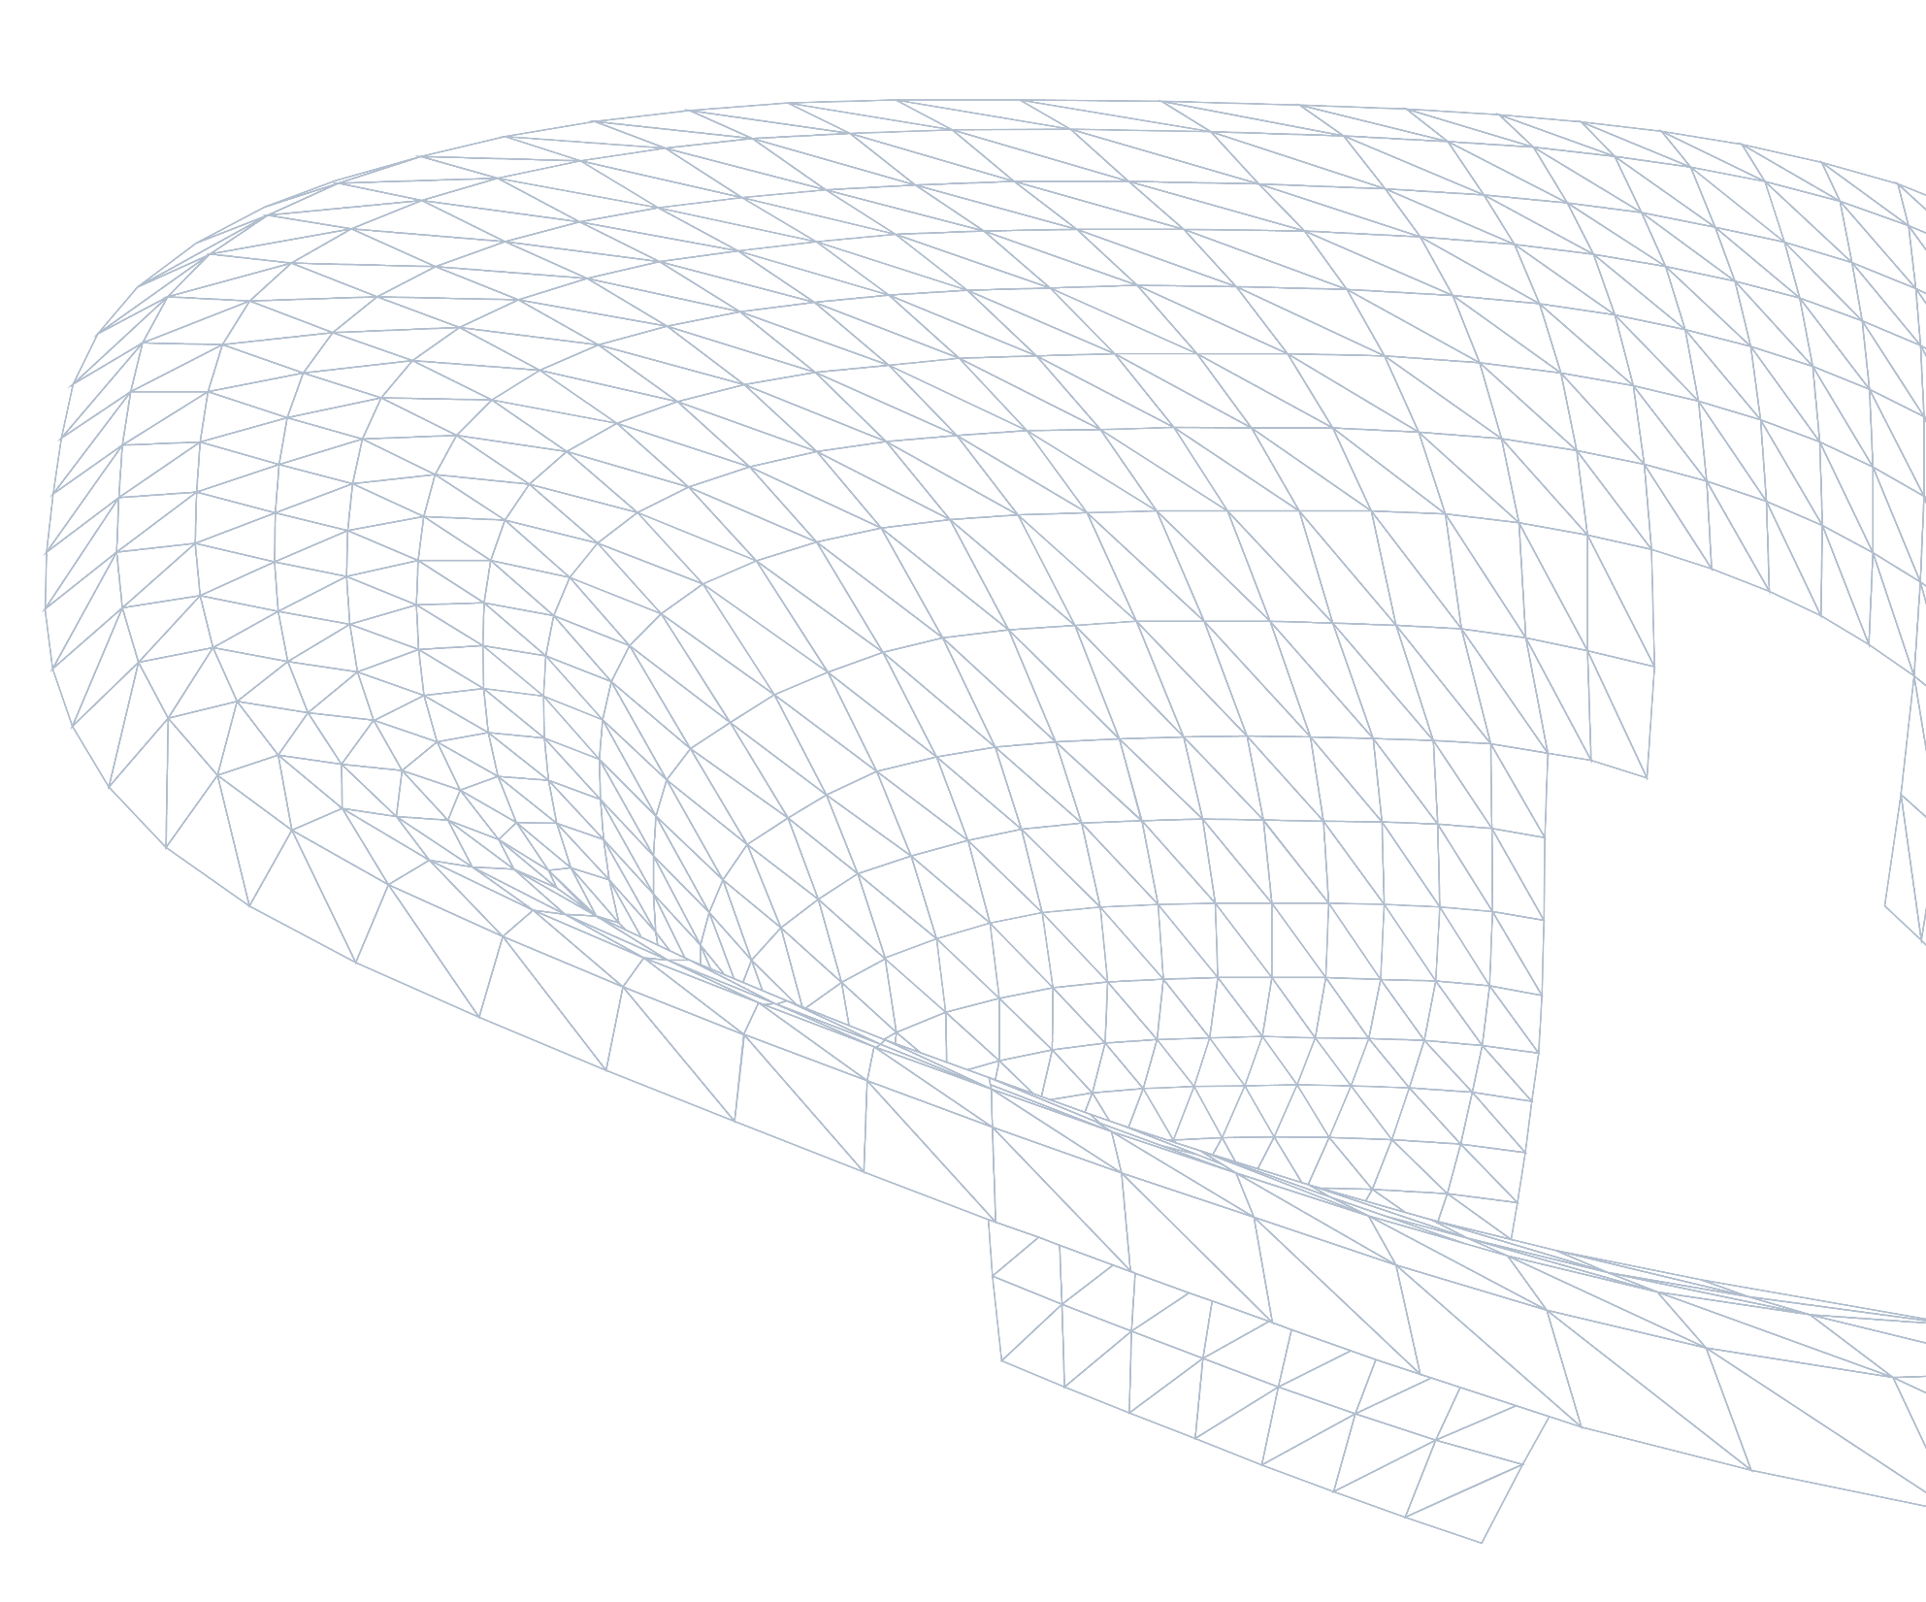
DFF - Robotic Lab Expansion
Environmental Study - Solar gains + Daylight
28/10/2026
Notes:
Title Slide – External Presentation
Update text for your presentation

Slide 2
Environmental design study
Schematic workflow to study effect of shading and glazing on radiation and daylight
(Study 1)
Façade geometry
Incident solar radiation on facade
Filter using allowable peak solar gain
+
Peak incident solar radiation
x
Glazing shading coefficient (SC)
Peak solar heat gain
Overhang depth
(study parameter)
(study parameter)
(MEP engineer input)
Selected configs studied further for daylight compliance
Aim: show how the depth of the roof canopy and the solar-control performance of the glass (shading coefficient, SC) reduce the solar heat gain through the façade; compare the result with the solar load the MEP's HVAC design allows for; and take the compatible options forward to a daylight check (sDA / ASE).
(Study 2)

Slide 3
Solar Heat Gain Analysis

Slide 4
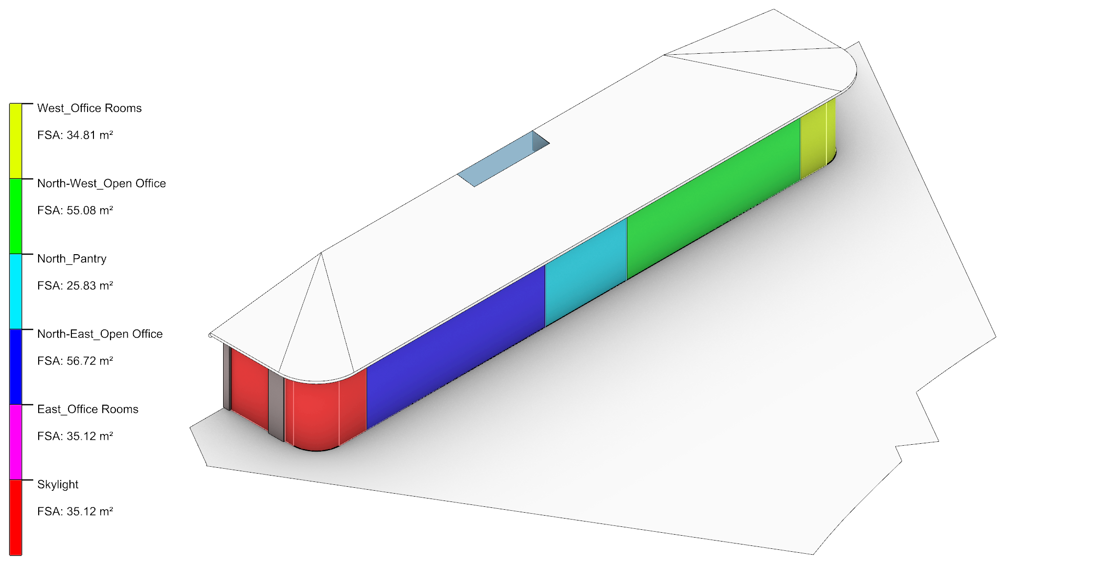
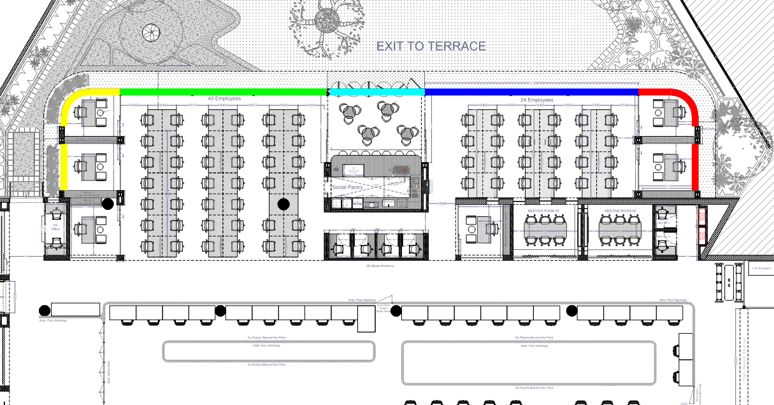
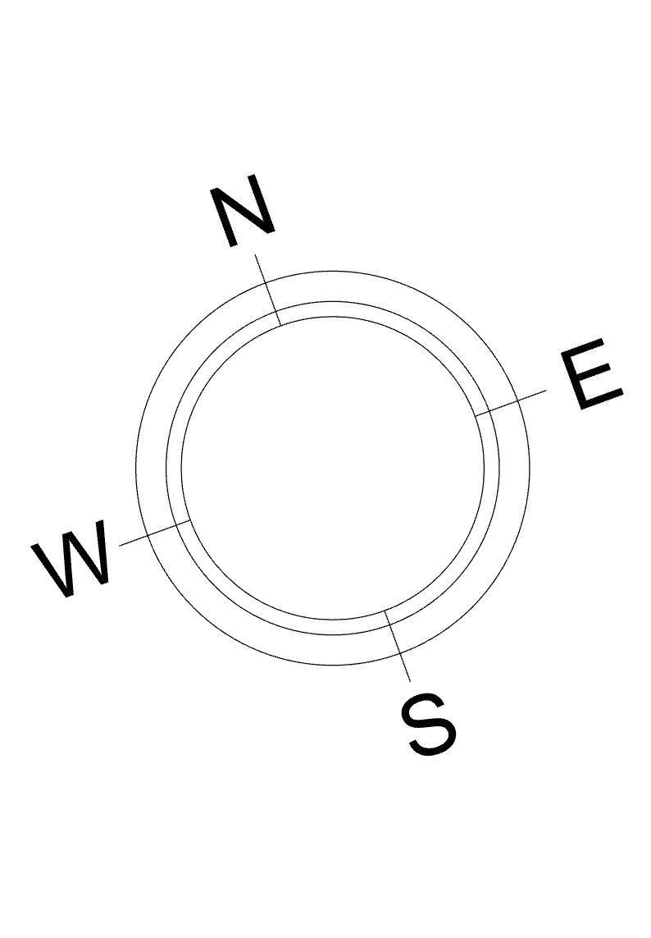
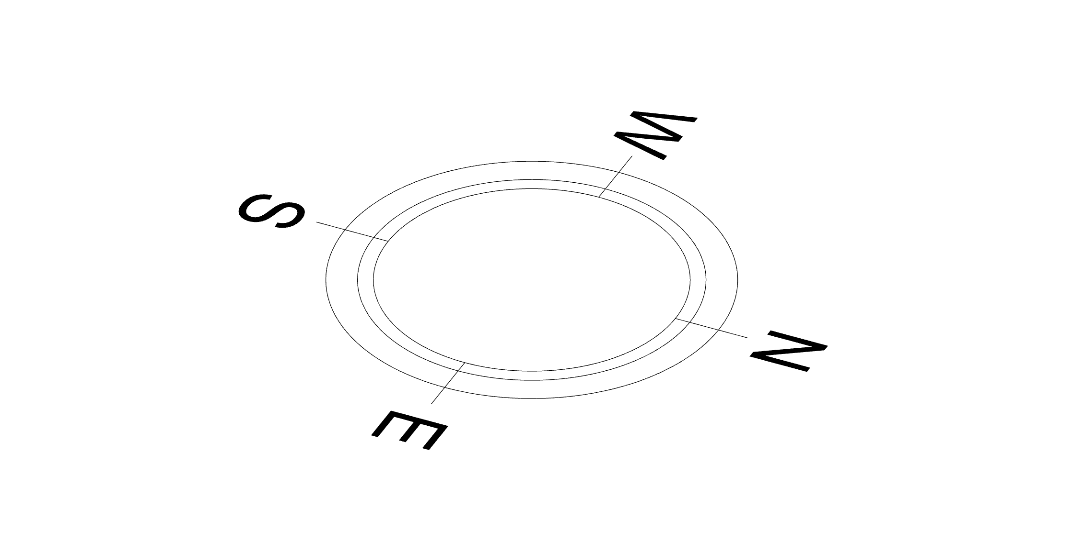
Façade Zones
Façade zones based on floor plan
Five façade zones shown in plan
Façade divide into five zones
Note: Set-up: the glazed façade is split into five zones that follow the floor plan, so every result can be traced back to a space.

Slide 5
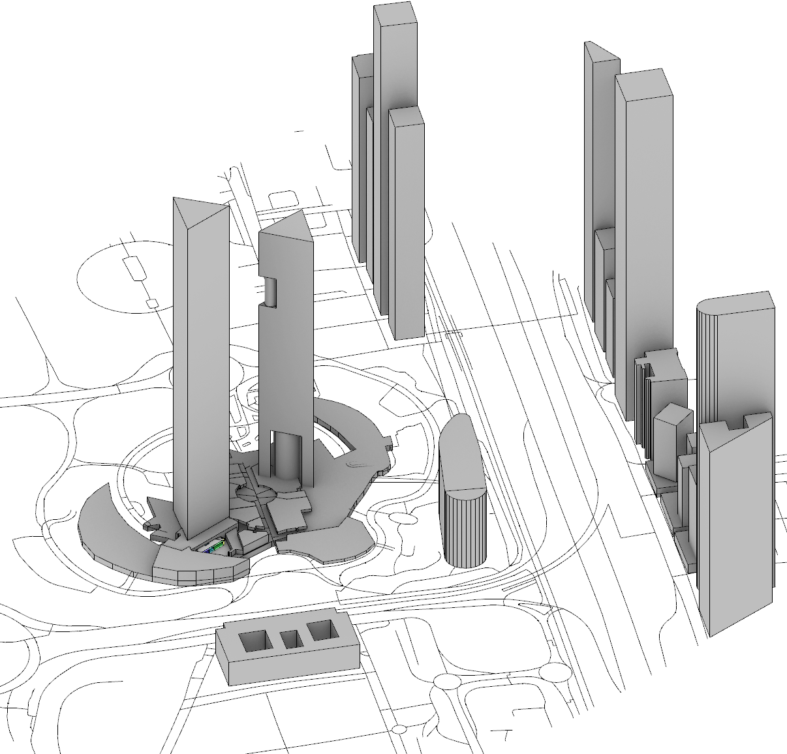
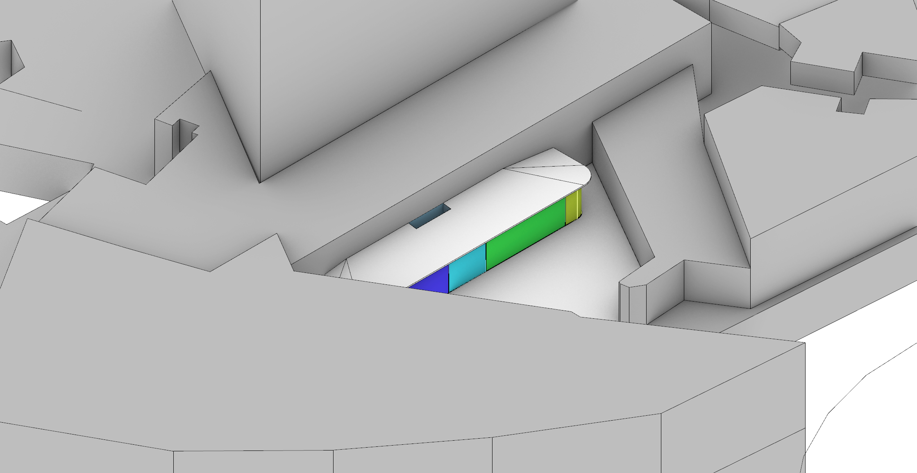
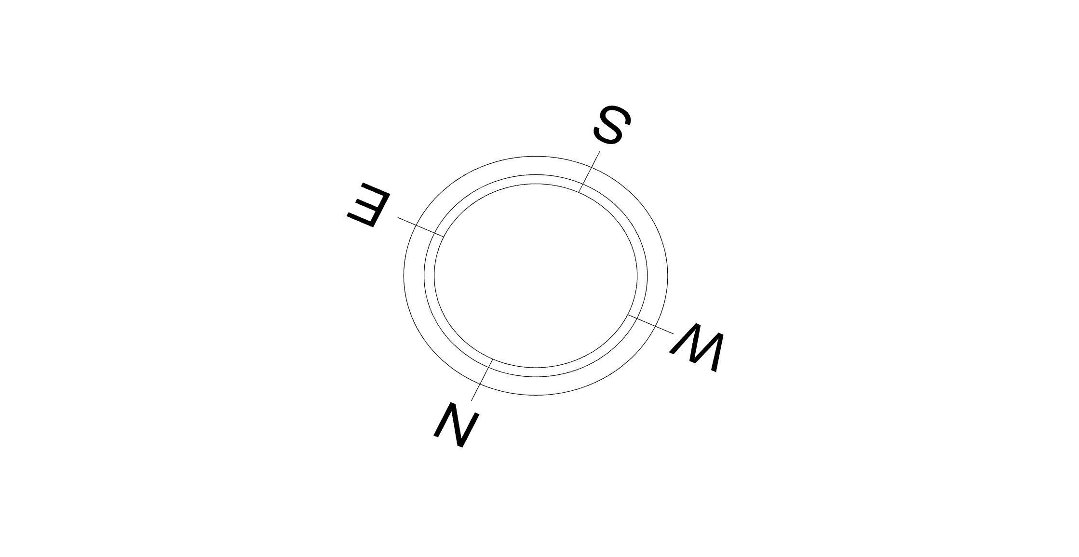
Analysis Geometry
Lab located along with its context
1 · Set-up: the pavilion is modelled with its surroundings; the neighbouring buildings shade much of the low east and west sun.
Façade model with context
Zoom-in of faced from North-west aerial view

Slide 6
Solar control using canopy

Slide 7
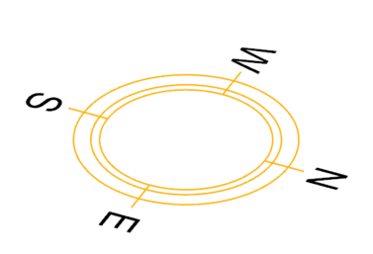
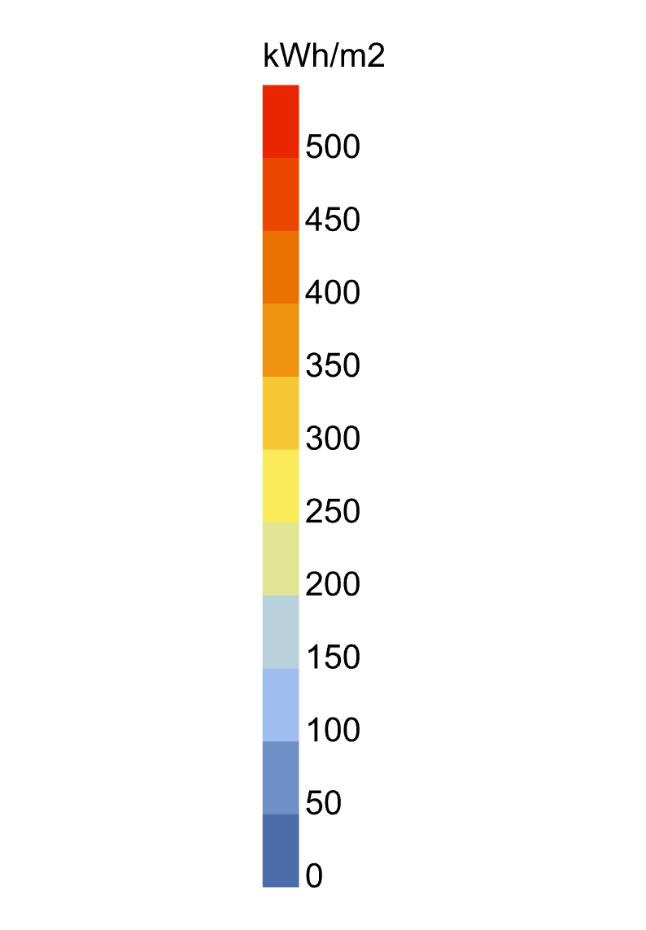
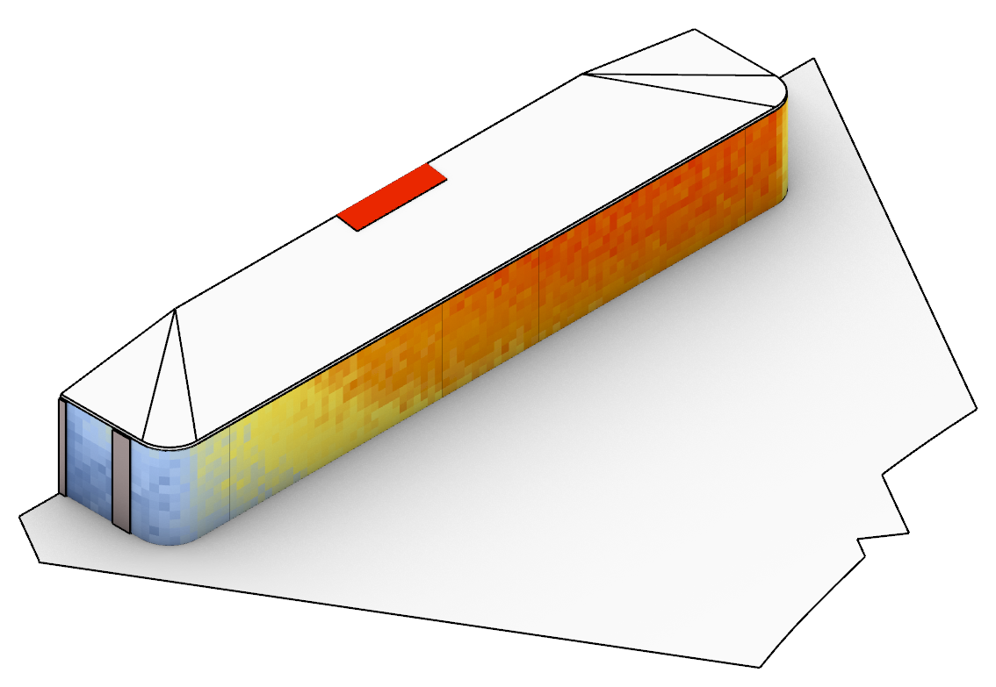
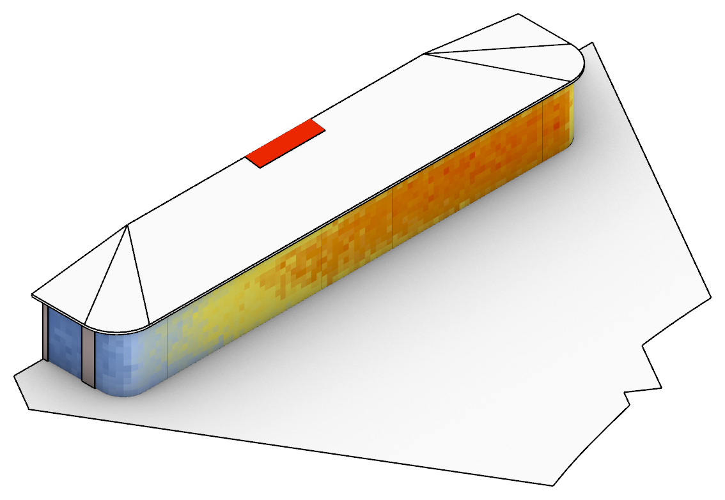
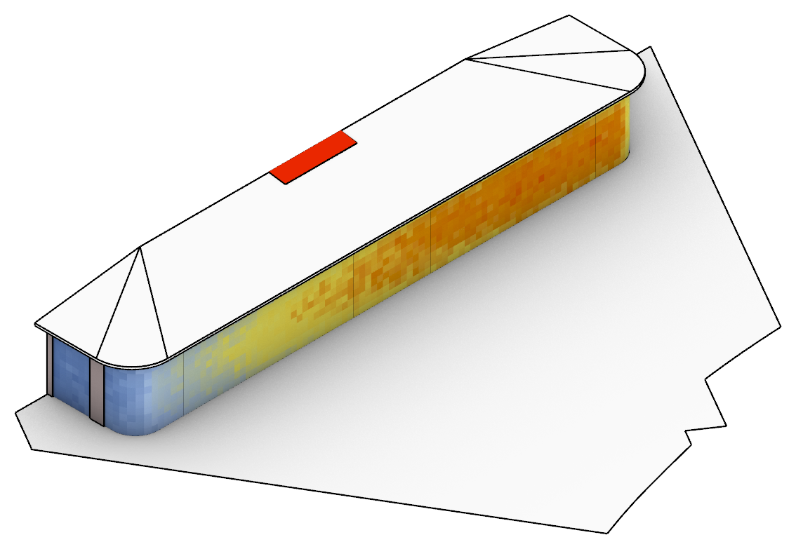
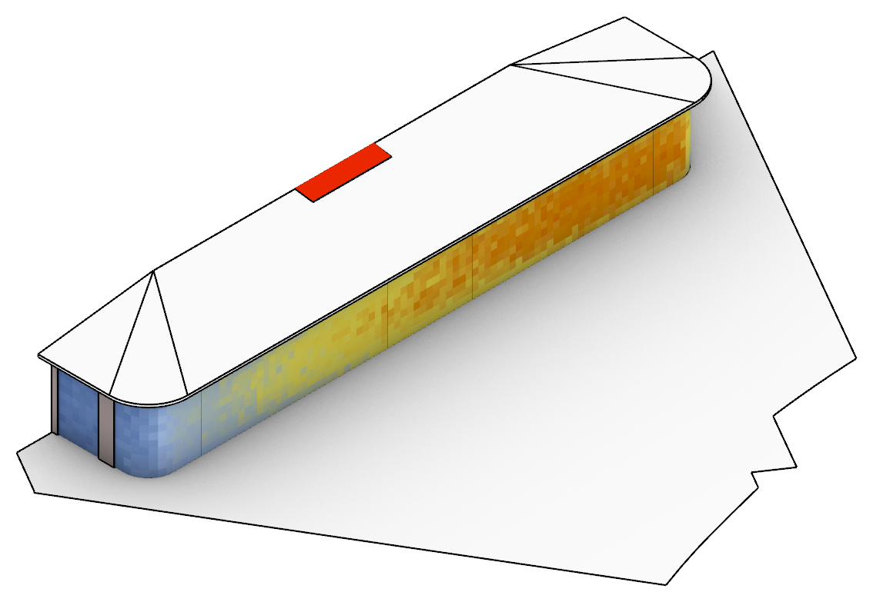
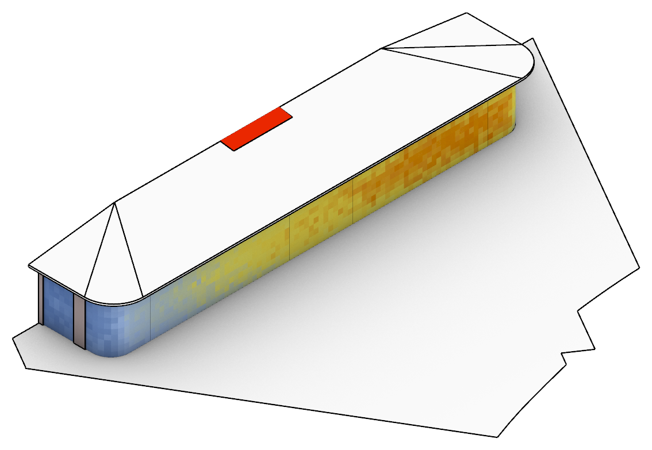
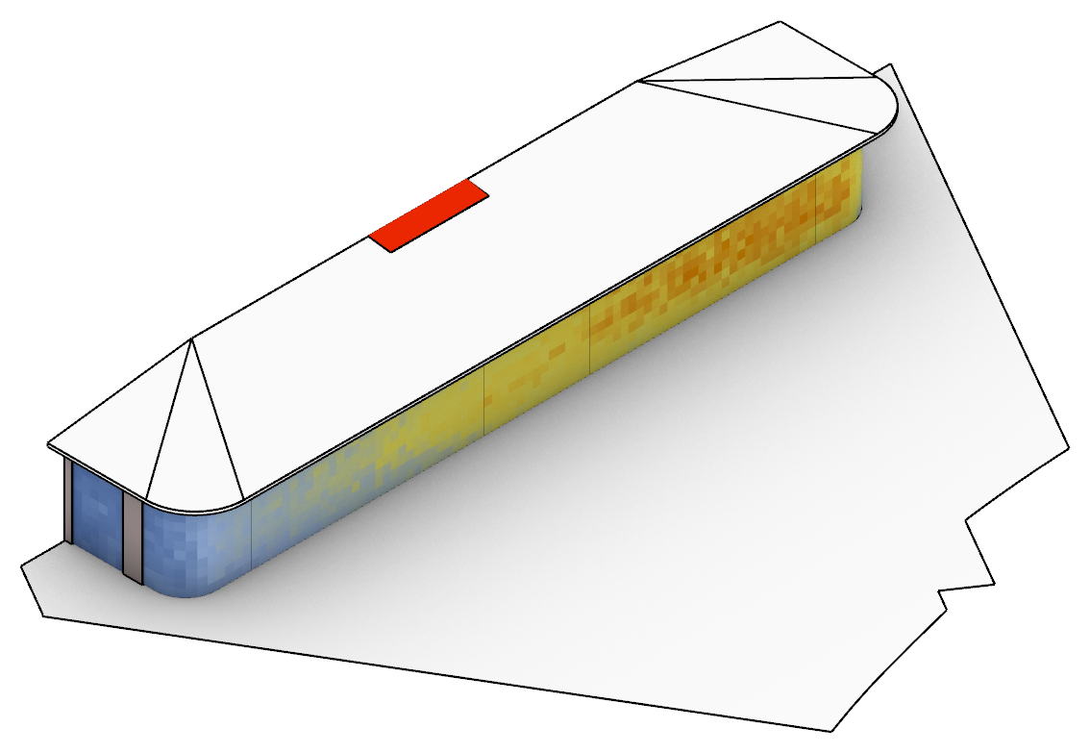
Incident Solar Radiation
Effect of canopy depth on incident façade radiation (typical year)
2 · How much sun reaches the glass: deepening the canopy from 0 to 1.5 m cuts annual façade radiation by a third (290.9 to 192.2 kWh/m²·yr) and the façade peak from 53.1 to 33.2 kW.
Architect's option 1
Architect's option 2
Overhang depth
0mm
Annual incident solar irradiation (façade mean)
290.9 kWh/m²·yr
Peak incident solar irradiance *
256 W/m²
Peak incident power (façade)
53.1 kW
@ 12-Jun 09:00
Overhang depth
500mm
Annual incident solar irradiation (façade mean)
247.1 kWh/m²·yr
Peak incident solar irradiance *
212 W/m²
Peak incident power (façade)
44.0 kW
@ 28-May 08:00
Overhang depth
750mm
Annual incident solar irradiation (façade mean)
231.5 kWh/m²·yr
Peak incident solar irradiance *
203 W/m²
Peak incident power (façade)
42.2 kW
@ 24-Jun 08:00
Overhang depth
1000mm
Annual incident solar irradiation (façade mean)
216.8 kWh/m²·yr
Peak incident solar irradiance *
190 W/m²
Peak incident power (façade)
39.5 kW
@ 12-Jun 08:00
Overhang depth
1250mm
Annual incident solar irradiation (façade mean)
202.8 kWh/m²·yr
Peak incident solar irradiance *
176 W/m²
Peak incident power (façade)
36.5 kW
@ 11-Jun 08:00
Overhang depth
1500mm
Annual incident solar irradiation (façade mean)
192.2 kWh/m²·yr
Peak incident solar irradiance *
160 W/m²
Peak incident power (façade)
33.2 kW
@ 11-Jun 08:00
* Peak incident solar irradiance on the façade glazing (area-weighted mean at the façade's peak hour) [W/m²]. Typical year (TMYx), side canopies 1.0 m on all options. The skylight (~745 kWh/m²·yr) is above the legend range.

Slide 8
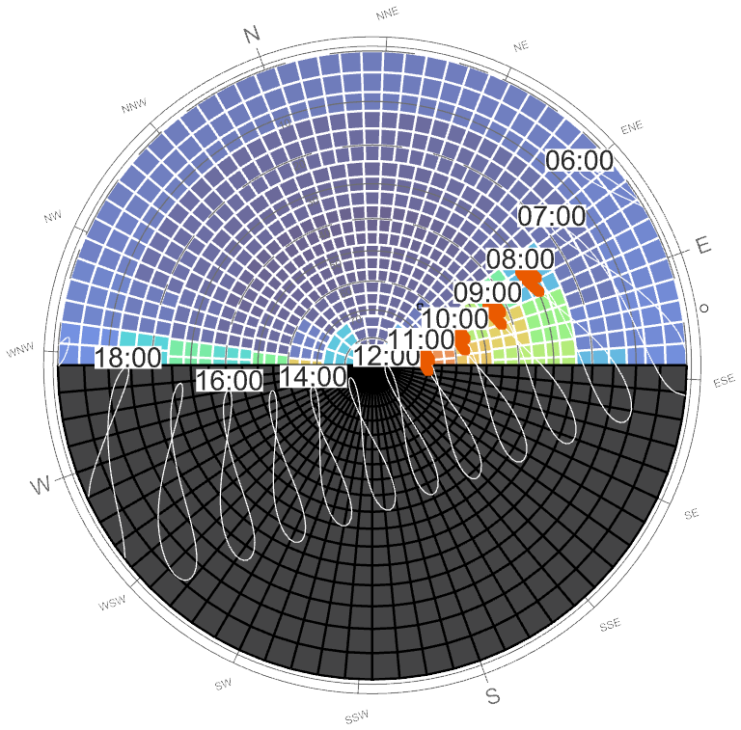
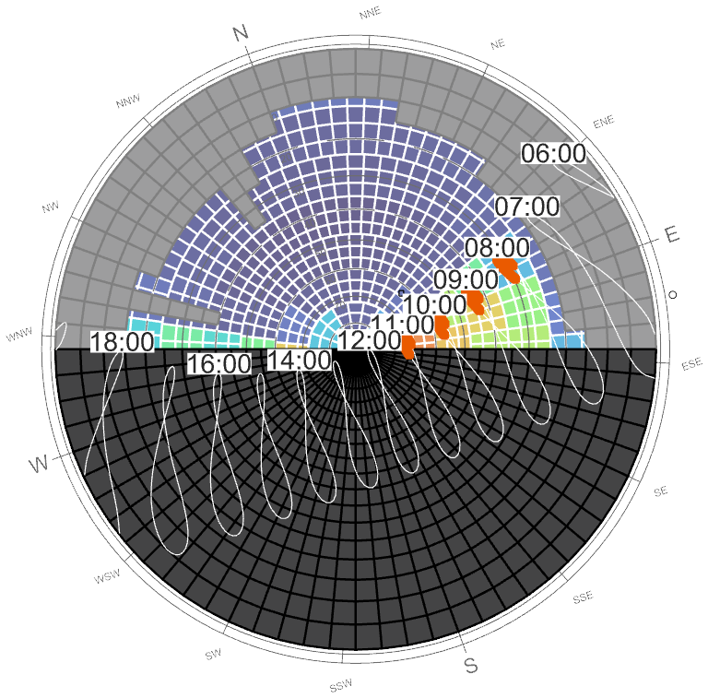
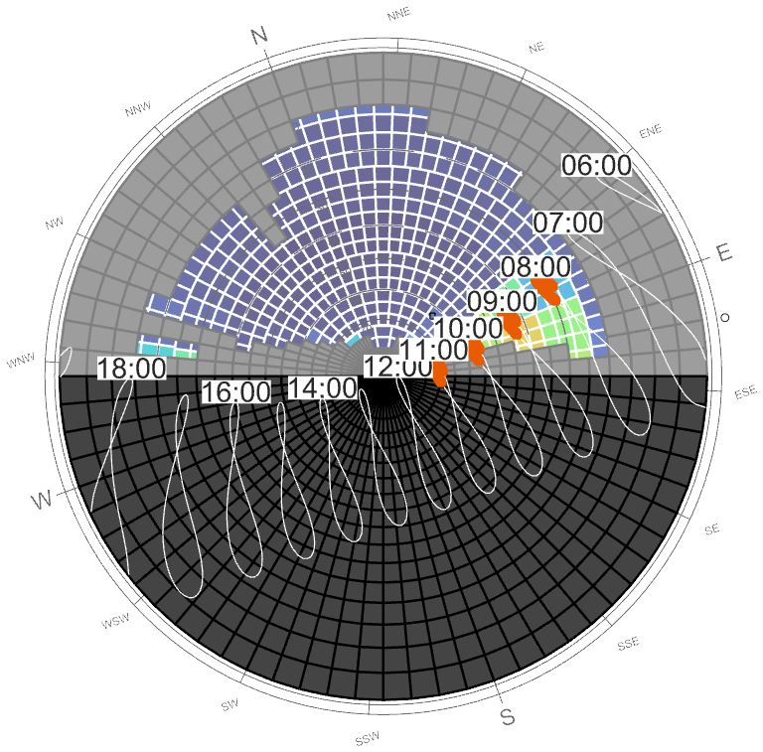
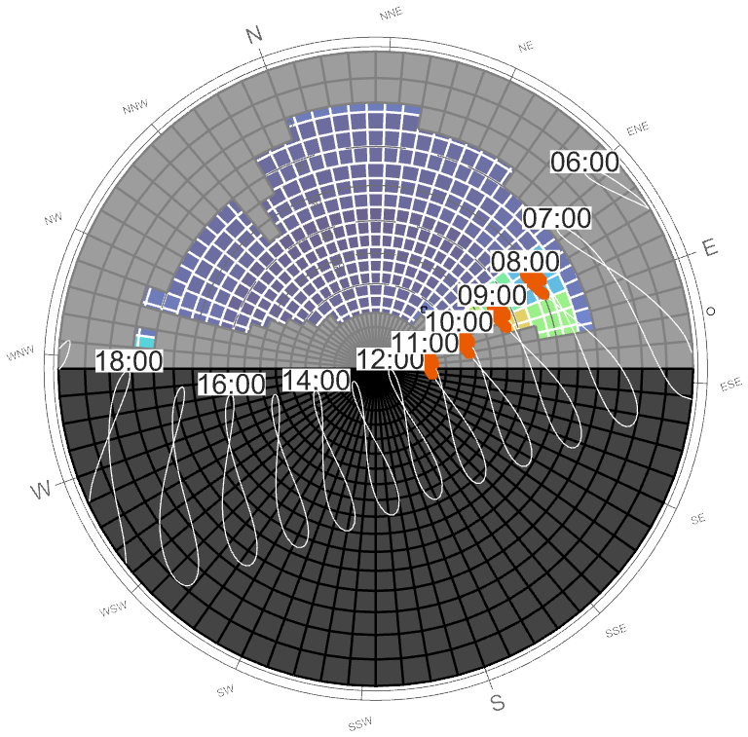
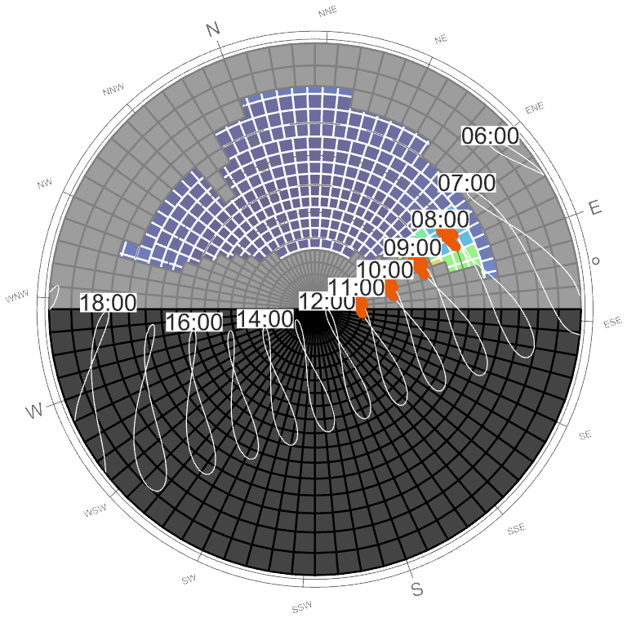
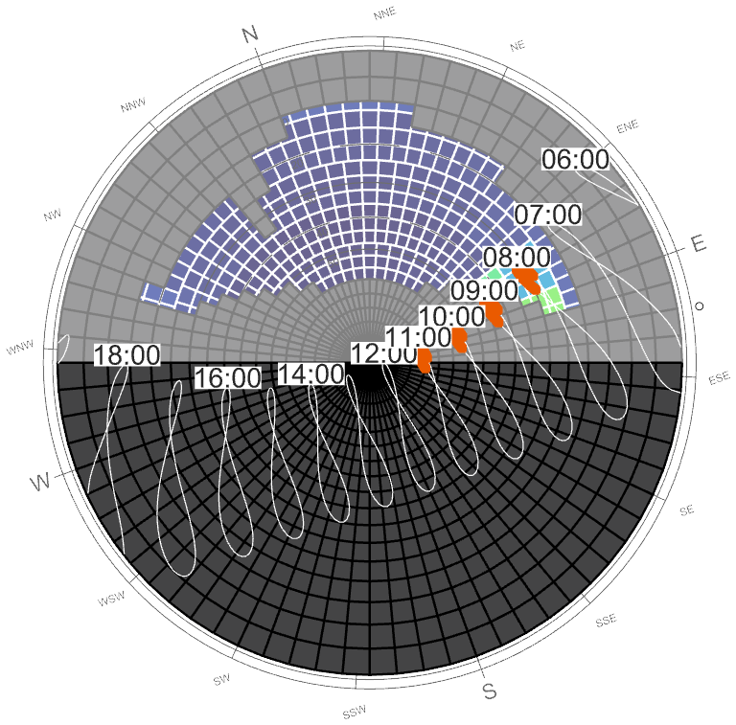


Sky Access & Shading Masks
Sun path, sky radiation and shading masks (North-West Open Office)
3 · When the peak arrives: only on May–July mornings (08:00–11:00), with the sun low in the east-north-east – a horizontal canopy can only partly block it.
Reference: 0 mm, no surroundings (all daylight hours)
0 mm + surroundings
500 mm + surroundings
750 mm + surroundings
Colours: solar radiation from each patch of sky, occupied hours (08–18, Mon–Fri) [kWh/m²]
Black: sky behind the façade
Grey: sky blocked by the canopy and surrounding buildings
White figure-8s: sun position at each clock hour through the year (labels on 21 June)
Orange: peak window, May–Jul 08:00–11:00 (hours with ≥ 80 % of the annual peak solar load)
1000 mm + surroundings (Architect's option 1)
1250 mm + surroundings
1500 mm + surroundings (Architect's option 2)
Deepening the canopy grows the grey mask down from the top of the sky. The sun that drives the peak (orange) sits low in the east-north-east: from the centre of the pane the deeper canopies hide the 10:00–11:00 sun, but the 08:00–09:00 sun still reaches the glass even at 1.5 m depth.
Take-away: the radiation peak on the façade happens on May–July mornings, so it is the morning sun that is driving the peak solar power on the facade.

Slide 9
Solar control using glass coating

Slide 10
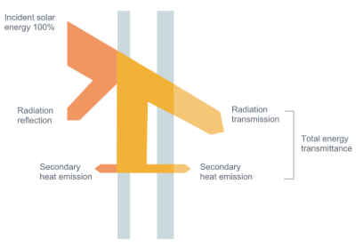
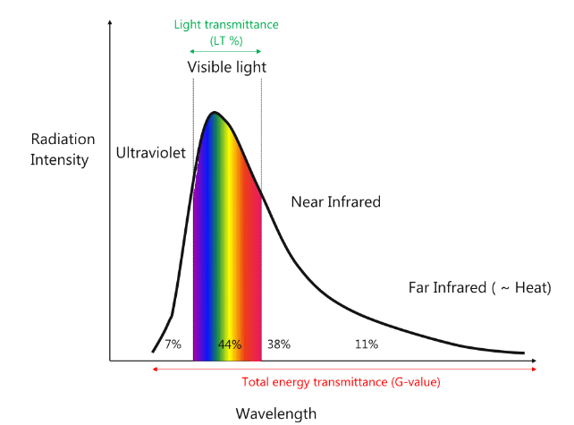
Glazing performance
Introduction
When designing glazing, the goal is to achieve a balance between views out, daylight, thermal insulation, and solar gains to ensure occupant comfort and wellbeing. Achieving the right balance between thermal performance and daylight quality depends on key parameters such as the U-value, g-value, and visible light transmission, which represent respectively the thermal insulation and solar control properties of the glass. Additional factors influencing solar performance include the color rendering index (CRI), which measures how closely the interior light resembles natural daylight.
The g-value represents the total energy transmitted through a glazing surface. It is composed of:
7% ultraviolet radiation,
44% visible light, with light transmittance measured across the visible spectrum only, and
49% infrared radiation, which contributes to solar heat gains.
Consequently, specifying a g-value below 0.44 will reduce the amount of transmitted visible light. Additionally, the color rendering index (CRI) drops significantly for coatings with a g-value below 0.4, affecting the quality of interior daylight.
Solar radiation reflection, transmission and emission scheme in an IGU
Schematic representation of g-value

Slide 11
Glass coating types
Overview
Less solar control
Less reflective
Less expensive
Higher CRI
Low-emissivity coatings:
Double silver coatings:
Triple silver coatings:
More solar control
More reflective
More expensive
Lower CRI
Magnetronic (soft) coatings
Control thermal performance of glazing unit rather than provide solar performance
Mostly used in residential scheme where solar gains are beneficial in winter
Blocks out a significant amount of infrared radiation while not blocking visible radiation.
Good colour rendering index (CRI) and can be used in areas where good daylight is required
Low selectivity (~1.5) but and low reflectivity.
Performance range:
  G-value: >0.50
  LT: >75%
Solar control, low emissivity coatings providing good thermal performance and reduction in solar gains
Made by layering up to 30 layers of microns thickness of metal oxides in a particular order using a sputtering machine, including 2 layers of silver.
Block out infrared radiation but the darker coatings also block a significant amount of visible radiation, leading to low CRI with blue, green or gold tinges
Good selectivity (~1.7)
Performance range:
  G-value: 0.15 - 0.40
  LT: 20% - 75%
Solar control, low emissivity coatings providing good thermal performance and excellent solar control
Made by layering up to 30 layers of microns thickness of metal oxides in a particular order using a sputtering machine, including 3 layers of silver, which reduces solar heat gain while maintaining good light transmittance.
Block out infrared radiation but the darker coatings also block some visible radiation, leading to low CRI with blue tinges.
Very good selectivity (>2)
Performance range:
  G-value: 0.14, LT: 35% (double silver equivalent is ~25%)
  G-value: 0.20, LT: 50% (double silver equivalent is ~40%)
  G-value: 0.28, LT: 60% (double silver equivalent is ~50%)
Proposed coating

Slide 12
Peak solar heat gain through glazing
Canopy depth x glass shading coefficient (SC) at the annual peak
4 · From radiation to heat gain: solar heat gain = incident solar × 0.87 × SC, shown for three glass options at the façade's annual peak.
Glass option | SC | SHGC (= 0.87 × SC) | Typical VLT | Al Sa'fat 2023 – whole-building WWR < 40 % * | Comment
Façade A | 0.25 | 0.22 | ~45–50 % | Meets (SC ≤ 0.40, LT ≥ 0.40) | Stronger solar control; least daylight
Façade B | 0.32 | 0.28 | ~65–70 % | Meets (SC ≤ 0.40, LT ≥ 0.40) | Best available at ~70 % VLT (top-end coating)
Façade C | 0.40 | 0.35 | ~70–72 % | Meets – at the SC limit | Code limit (whole-building reading); MEP's HAP assumption
Skylight | 0.25 | 0.22 | ~40 % | Meets (roof glazing ≤ 10 %) | All options; fritting optional
* Assumes the lab is assessed with the existing tower (combined WWR < 40 %: SC ≤ 0.40, LT ≥ 0.40, summer U ≤ 2.1 W/m²K) – to be confirmed. VLT values are typical estimates.
Overhang depth | Peak solar heat gain, window + skylight (typical year TMYx) |  |  | Combined heat-gain peak hour | Peak incident solar on façade
 | SC 0.25 | SC 0.32 | SC 0.40
[mm] | [kW] | [kW] | [kW] | [hour start] | [kW]
0 mm | 12.56 | 15.79 | 19.49 | 12-Jun 09:00 | 53.1
500 mm | 10.49 | 13.14 | 16.17 | 12-Jun 09:00 | 44.0
750 mm | 9.96 | 12.53 | 15.47 | 24-Jun 08:00 | 42.2
1000 mm | 9.40 | 11.80 | 14.55 | 12-Jun 08:00 | 39.5
1250 mm | 8.76 | 10.99 | 13.53 | 11-Jun 08:00 | 36.5
1500 mm | 8.02 | 10.04 | 12.35 | 11-Jun 08:00 | 33.2
Solar heat gain = 0.87 × SC × incident solar (façade) + 0.87 × 0.25 × incident solar (skylight), at the hour of the annual maximum (typical year, TMYx 1973–2025).
The three columns showing peak (kW) are the highest hourly solar heat gain through façade + skylight over the whole typical year, for each façade glass (the skylight is SC 0.25 throughout). Peak hour is when that worst hour occurs which is always a June morning, 08:00–10:00. The last column is the sun reaching the façade before the glazing filters it. It's the raw input that the canopy controls.

Slide 13
Window + Skylight Solar Heat Gain
Canopy depth x glass SC vs the previous HAP solar-load reference
5 · Check against the MEP engineer’s HAP model dated 21/08/2026 : with SC 0.40 (~70 % VLT) every depth exceeds its 4.7 kW solar component; SC 0.25 glass with ≥ 750 mm stays at or below it.
Canopy depth | Façade incident solar, MEP July hour | Heat gain at MEP July hour (21 Jul, ~14:00) |  |  | Heat gain at MEP June hour (21 Jun, ~13:00), SC 0.40 | Annual maximum heat gain, SC 0.40 | Annual maximum: hour start | Highest façade SC that stays ≤ 4.7 kW at the July hour
 |  | SC 0.25 | SC 0.32 | SC 0.40
[mm] | [kW] | [kW] | [kW] | [kW] | [kW] | [kW] | [date hh:mm] | [-]
0 mm | 25.12 | 5.72 | 7.25 | 9.00 | 11.52 | 19.62 | 20-Jun 09:00 | 0.20
500 mm | 21.29 | 4.90 | 6.20 | 7.68 | 10.17 | 16.43 | 20-Jun 09:00 | 0.24
750 mm | 19.96 | 4.61 | 5.83 | 7.22 | 9.74 | 14.47 | 20-Jun 09:00 | 0.25
1000 mm | 18.83 | 4.36 | 5.51 | 6.82 | 9.08 | 13.51 | 16-Jun 08:00 | 0.27
1250 mm | 17.97 | 4.15 | 5.25 | 6.50 | 8.65 | 12.37 | 16-Jun 08:00 | 0.29
1500 mm | 16.89 | 3.95 | 4.98 | 6.15 | 8.12 | 11.31 | 18-Jun 08:00 | 0.30
Clear-sky design day (ASHRAE tau model, Dubai Intl. AP) on 21 Jul / 21 Jun, taking the higher of the two hours either side of the previous HAP times (sun at 13:30/14:30 and 12:30/13:30). Using the highest of all July days instead of the 21st raises July values by ~15–20 % (1500 mm, SC 0.40: 6.15 → 7.28 kW). Solar heat gain = 0.87 × (SC × façade incident + 0.25 × skylight incident).
≤ 4.7 kW – at or below the MEP engineer’s HAP solar-load reference (not an agreed limit)
Key points
With SC 0.40 (~70 % VLT) the July heat gain is 6.15–9.00 kW: above the MEP engineer’s HAP reference (4.75 kW) at every depth; 1500 mm comes closest.
SC 0.25 glass stays at or below the reference from 750 mm (4.61 kW) to 1500 mm (3.95 kW); SC 0.32 does not (4.98 kW at 1500 mm).
The annual maximum falls on June mornings (11.3–19.6 kW at SC 0.40), above the July value considered by the MEP.
Per m² of glass the July heat gain at SC 0.40 is 29–42 W/m², against 74 W/m² in the previous HAP model; the glazed area is 3.3× larger (213.7 vs 64 m²). MEP engineer to confirm the glazing areas.
The last column is the highest façade SC that keeps the window + skylight heat gain at or below 4.7 kW at the July design hour (21 July, ~14:00).

Slide 14
Clear-Sky Design Day vs Typical Year
Heat gain at SC 0.40: MEP July hour vs annual maximum
6 · Timing: this façade's heat gain peaks on June mornings, 5.2–6.5 kW above its July-afternoon value at 1500 mm.
Canopy depth | Heat gain at MEP July hour (~14:00) |  | Annual maximum heat gain
 | Design day (21 Jul) | Typical year (highest July day) | Design day | Hour start | Typical year | Hour start
[mm] | [kW] | [kW] | [kW] | [date hh:mm] | [kW] | [date hh:mm]
0 mm | 9.00 | 8.60 | 19.62 | 20-Jun 09:00 | 19.49 | 12-Jun 09:00
500 mm | 7.68 | 6.94 | 16.43 | 20-Jun 09:00 | 16.17 | 12-Jun 09:00
750 mm | 7.22 | 6.71 | 14.47 | 20-Jun 09:00 | 15.47 | 24-Jun 08:00
1000 mm | 6.82 | 6.42 | 13.51 | 16-Jun 08:00 | 14.55 | 12-Jun 08:00
1250 mm | 6.50 | 6.12 | 12.37 | 16-Jun 08:00 | 13.53 | 11-Jun 08:00
1500 mm | 6.15 | 5.82 | 11.31 | 18-Jun 08:00 | 12.35 | 11-Jun 08:00
Façade SC 0.40, skylight SC 0.25. Design day = ASHRAE clear sky (tau model, 2009 coefficients; Dubai Intl. AP), 21st of the month. Typical year = TMYx Dubai Intl. AP (source period 1973–2025), highest July day. Hour start, e.g. 08:00 = 08:00–09:00, local standard time. Solar heat gain, not a HAP cooling load; no safety factor.
≤ 4.7 kW – at or below the MEP’s HAP solar-load reference
Key points
Both skies put the annual maximum on June mornings (08:00–10:00), not at the previously considered MEP’s HAP design hour (July 14:00).
At 1500 mm the annual maximum exceeds the July value by 5.2 kW on the design day (11.31 vs 6.15) and 6.5 kW in the typical year (12.35 vs 5.82).
The two skies agree on the timing of the peak but not exactly on the peak value itself, so both are reported.
Deeper canopies lower both values, but at SC 0.40 even 1500 mm stays above 4.7 kW.

Slide 15
Radiation Study Assumptions
Inputs for the current six-depth solar screening (slides 5–9).
Method: Honeybee/Radiance annual incident irradiance on the glazing (0.4 m sensor grid, -ab 3). North canopy 0 / 0.5 / 0.75 / 1.0 / 1.25 / 1.5 m; side canopies 1.0 m; skylight included.
Weather: Dubai Intl. AP TMYx (source period 1973–2025) and an ASHRAE clear-sky design day (tau model, Ladybug default 2009 coefficients with the STAT optical depths; the 2017 coefficients give ~1–4 % higher loads). Design-day values use the 21st of the month.
Solar heat gain = 0.87 × SC × incident solar (constant SHGC): instantaneous gain, not a HAP cooling load.
Reference: previous HAP solar-load components 4.752 kW (zone peak, Jul 14:00) and 4.644 kW (air-system design-report condition, Jun 13:00), before the 10 % safety factor.
Compliance (to confirm with the permit consultant): pavilion assessed with the existing tower, combined WWR < 40 % → SC ≤ 0.40, LT ≥ 0.40, summer U ≤ 2.1 W/m²K (Al Sa'fat 2023).
Sun-path dome: occupied hours 08:00–18:00, Mon–Fri. Surface reflectance:
Surface | Reflectance
Glazing | 0.20
Opaque façade | 0.40
Roof / overhang | 0.50
Ground (light paver, weathered) | 0.35
Context | 0.30
Far-field ground (sky model) | 0.20

Slide 16
Daylight Analysis

Slide 17
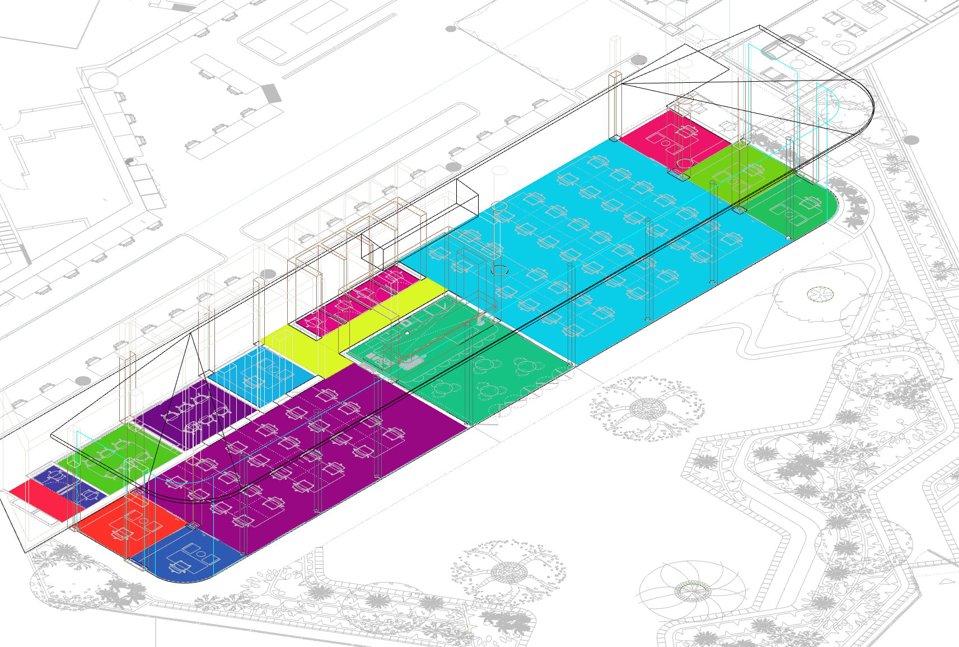
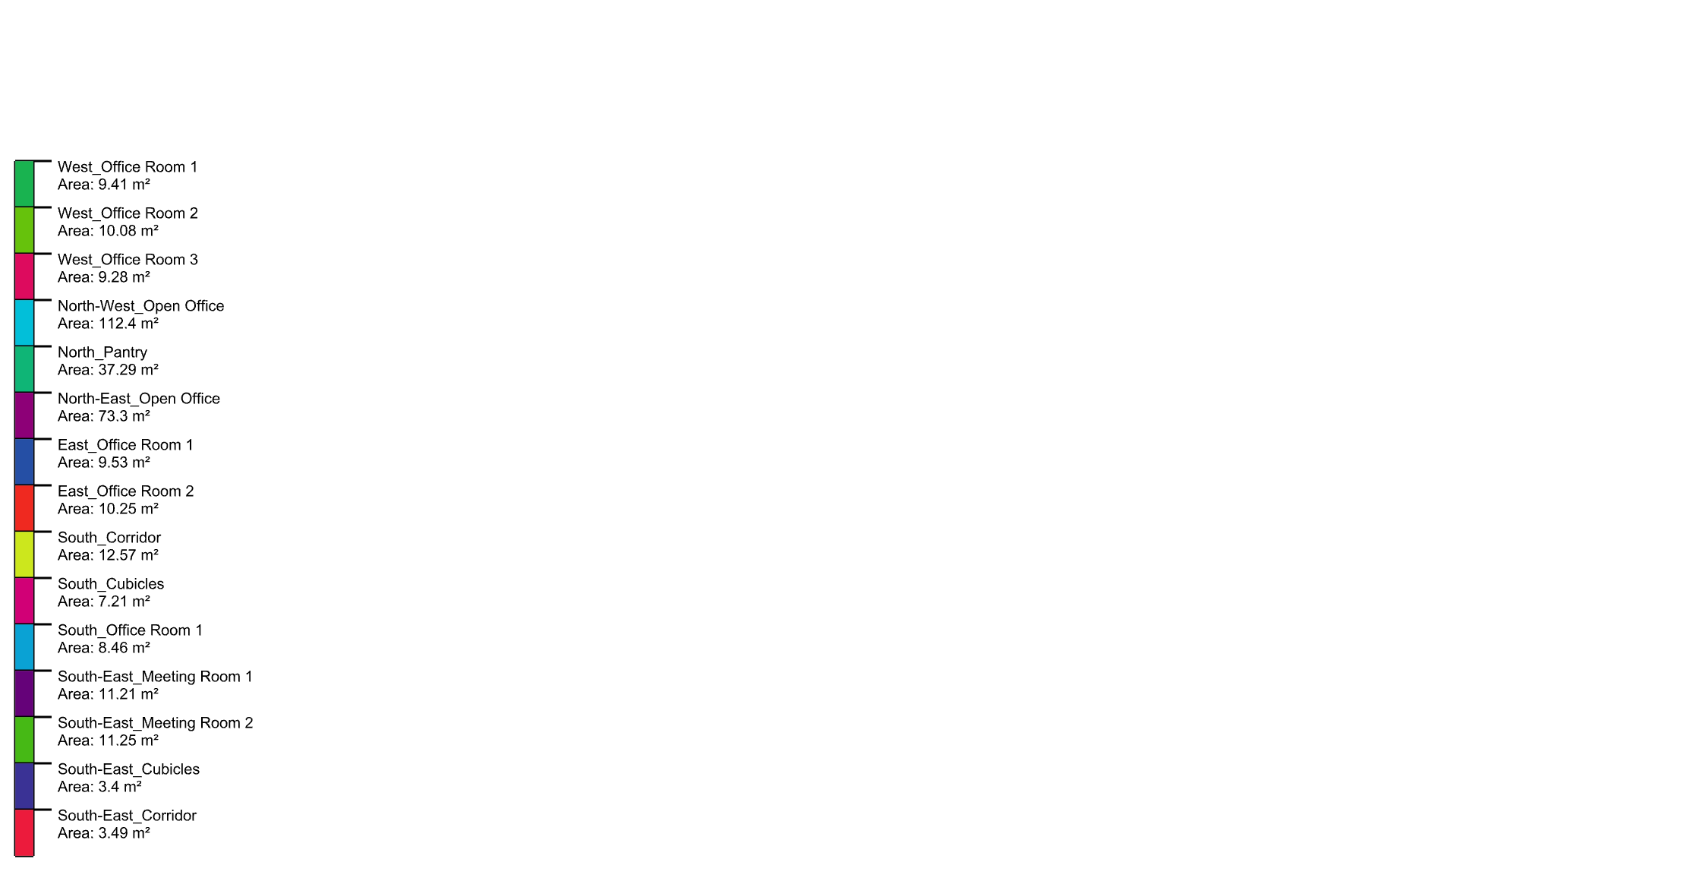
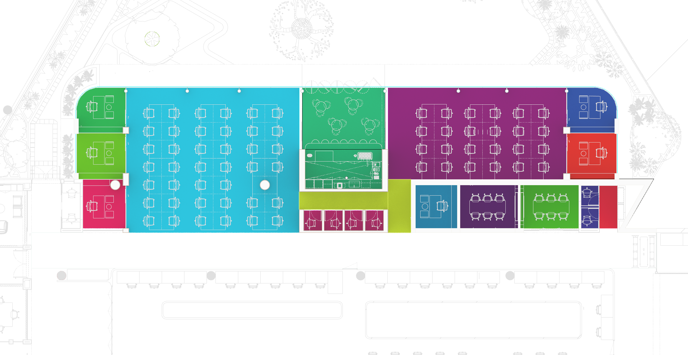
Façade Zones
Façade zones based on floor plan
Daylight analysis zones shown in plan
Floor area divided into zones for daylight analysis

Slide 18
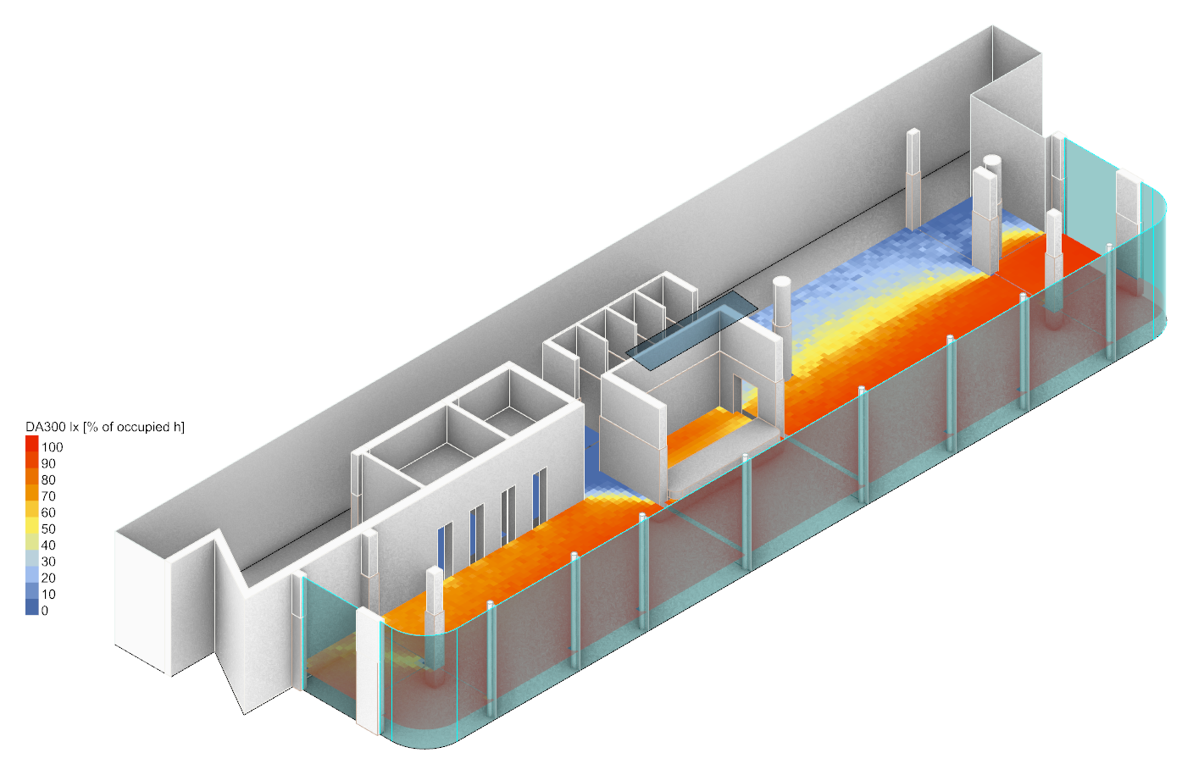
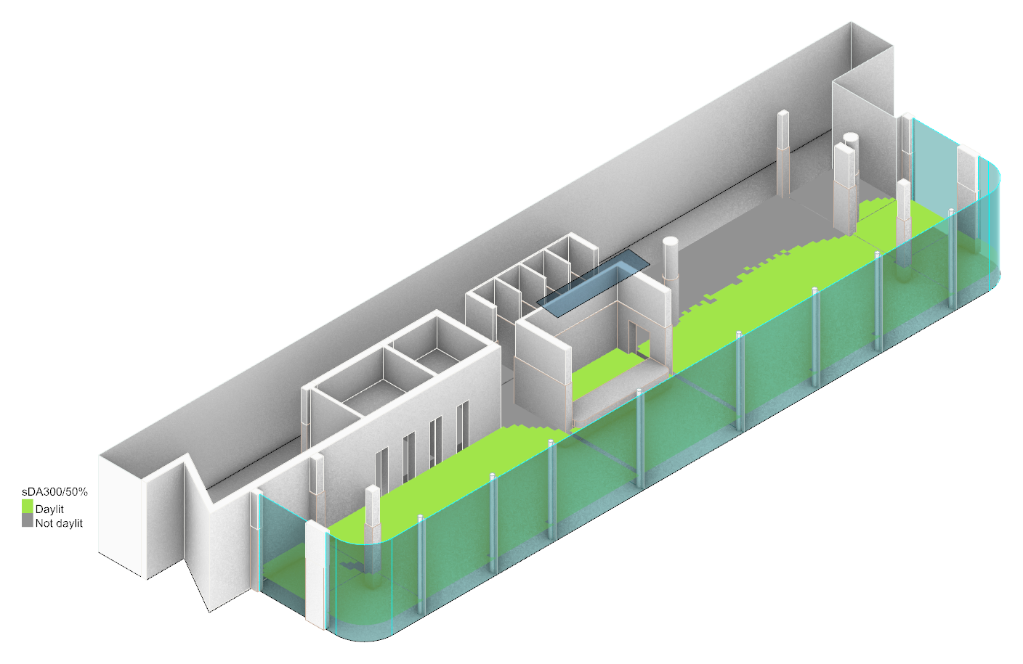
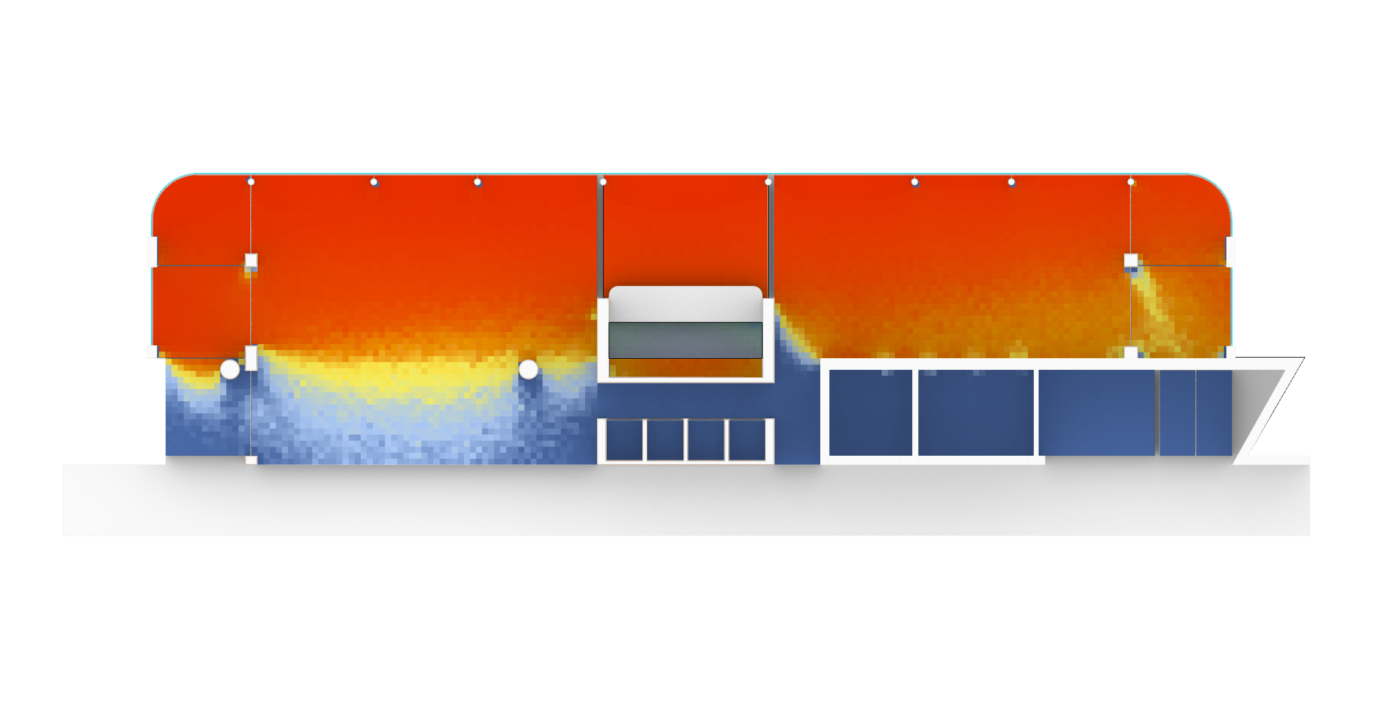
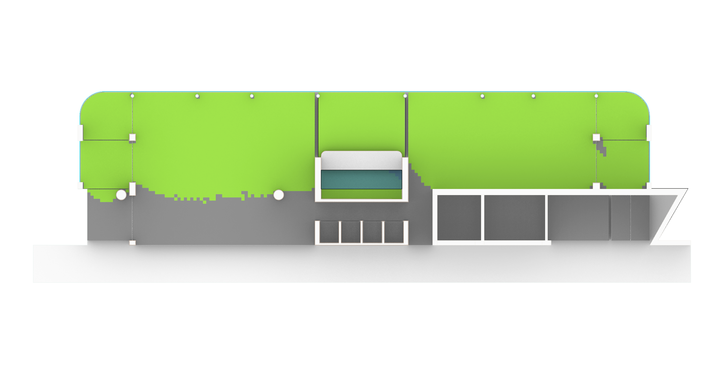
Spatial Daylight Autonomy
Daylit floor area with the 1500 mm canopy;
Tvis: 62% (facade) & 38% (skylight)
7 · Daylight: 66 % of the analysed floor area (82 % of the glazed rooms) gets at least 300 lx for half of the occupied hours; the enclosed rooms get little or none.
Spatial Daylight Autonomy (sDA_{300,50%})
66 %
Daylight autonomy DA300: share of occupied hours with at least 300 lx
sDA300/50%: daylit where DA300 is at least 50 %
Key points
Whole analysed floor (15 areas, 329 m²): sDA 66 %. The 7 glazed rooms (262 m²): sDA 82 %.
The open offices, pantry and four wing offices are daylit (67–98 %); the 9.7 m deep NW open office is lowest – 67% (DA about 97 % at the glass, 14 % at the back).
The eight enclosed rooms have no external glazing: West Office Room 3 reaches 13 % on borrowed light, the other seven 0 %.
Benchmark (IES LM-83 / LEED v4.1): sDA300/50% at least 55 % (75 % preferred) of the regularly occupied area.
Honeybee/Radiance annual daylight (enhanced 2-phase), Dubai TMYx, occupied hours Mon–Fri 08:00–18:00, 0.2 m grid at 0.76 m. No blinds are modelled.

Slide 19
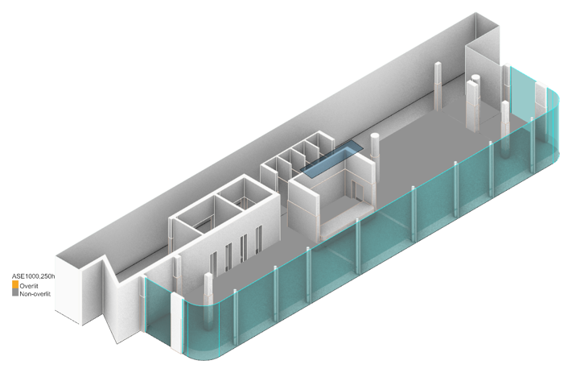
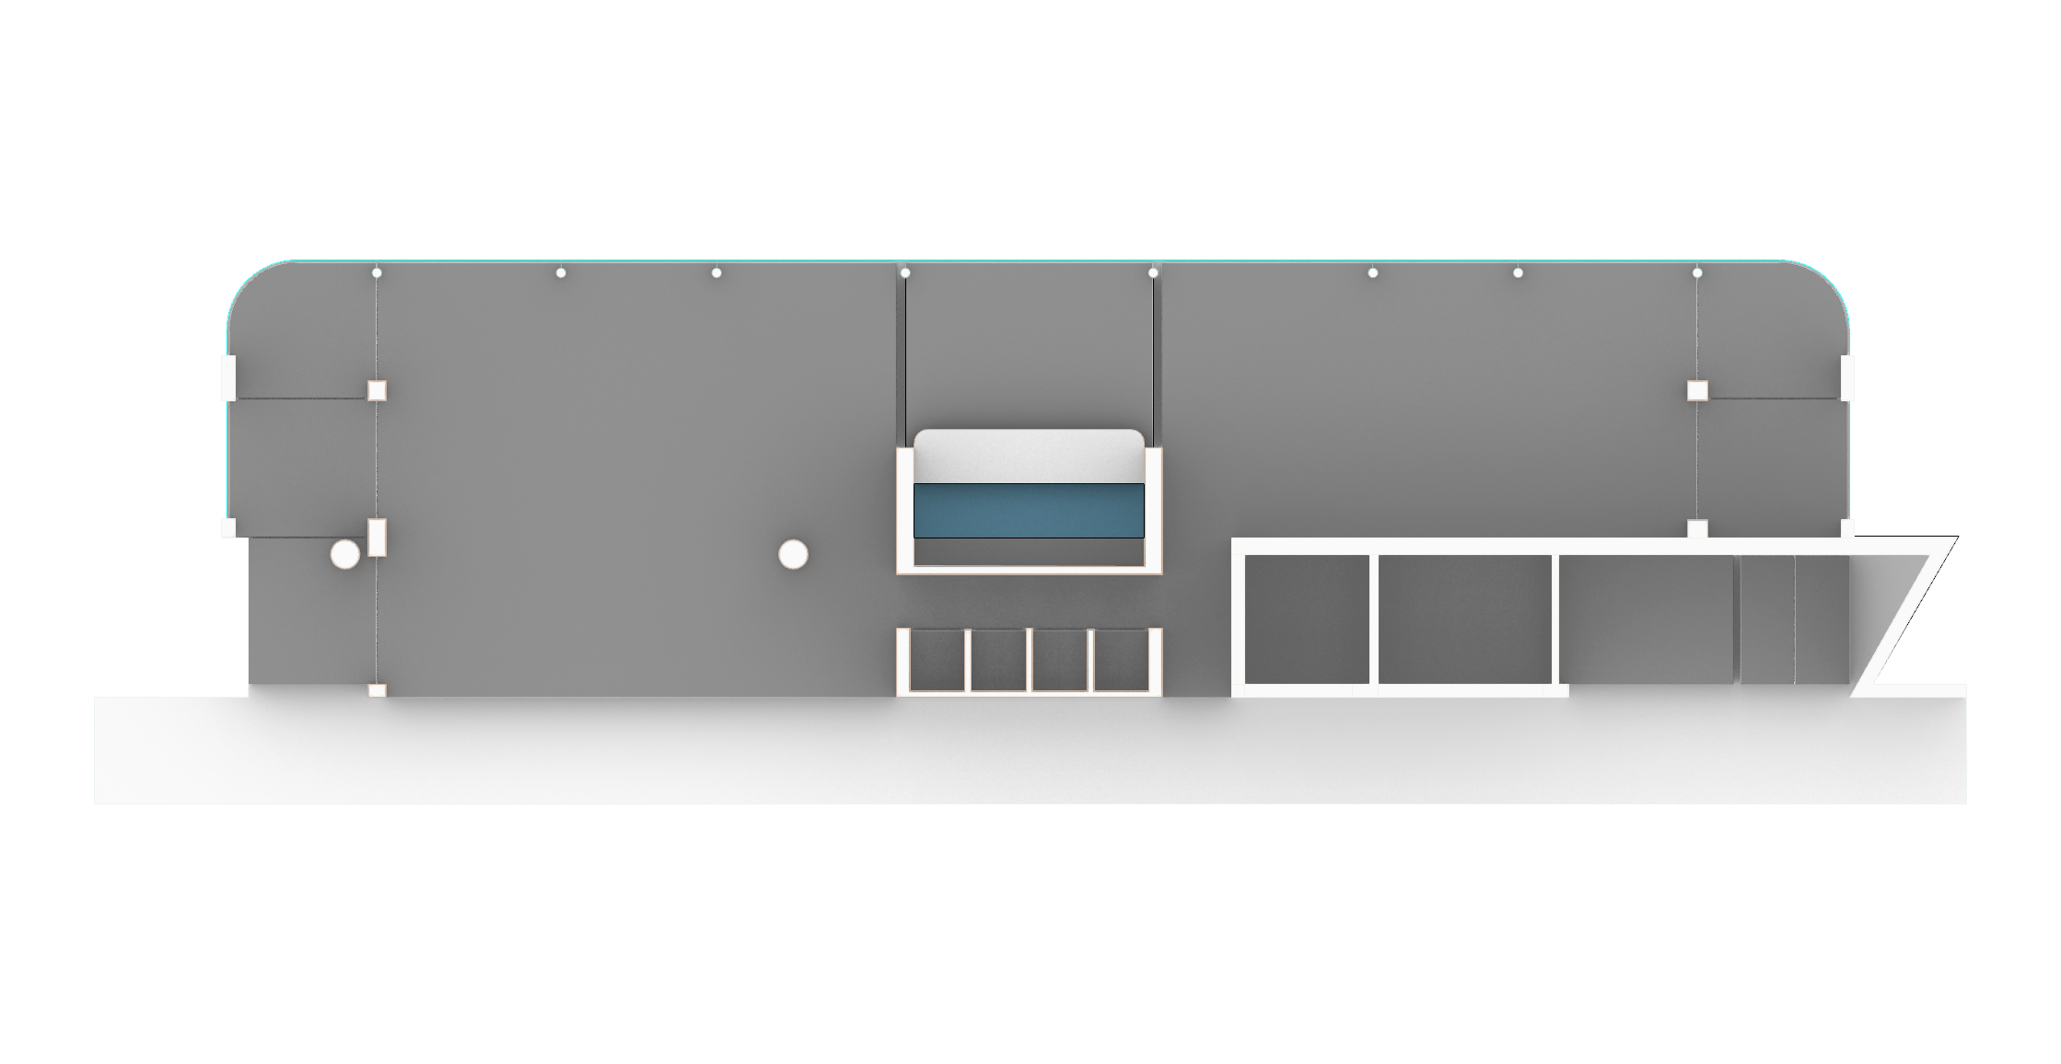
Annual Sunlight Exposure
Direct-sun hours and results by area (1500 mm canopy)
8 · Direct sun: ASE1000,250 is 0 % in every area; the most exposed spot, under the skylight, sees 198 occupied hours above 1000 lx.
Annual Sunlight Exposure
(ASE_{1000,250h})
0 %
Area | Floor area [m²] | sDA300/50% [%] | ASE1000,250h [%] | Max hours > 1000 lx [h]
West Office Room 1 | 9.4 | 97 | 0 | 133
West Office Room 2 | 10.1 | 98 | 0 | 18
West Office Room 3 | 9.3 | 13 | 0 | 0
North-West Open Office | 112.4 | 67 | 0 | 137
North Pantry | 37.3 | 83 | 0 | 198
North-East Open Office | 73.3 | 98 | 0 | 88
East Office Room 1 | 9.5 | 97 | 0 | 40
East Office Room 2 | 10.2 | 92 | 0 | 30
South Corridor | 12.6 | 0 | 0 | 0
South Cubicles | 7.2 | 0 | 0 | 0
South Office Room 1 | 8.5 | 0 | 0 | 0
South-East Meeting Room 1 | 11.2 | 0 | 0 | 0
South-East Meeting Room 2 | 11.2 | 0 | 0 | 0
South-East Cubicles | 3.4 | 0 | 0 | 0
South-East Corridor | 3.5 | 0 | 0 | 0
Glazed rooms (7) | 262.3 | 82 | 0 | 198
All analysed areas (15) | 329.1 | 66 | 0 | 198
Occupied hours with more than 1000 lx of direct sun (Mon–Fri 08:00–18:00)
Key points
ASE is 0 % everywhere: no point gets over 1000 lx of direct sun for more than 250 occupied hours.
At the glass, sun above 1000 lx comes mainly at 07:00–09:00 (Apr–Sep), largely before 08:00; worst glass-side spots: 88 h (NE open office), 133 h (West Office Room 1).
Under the skylight: up to 198 h in the pantry and 137 h at the edge of the NW offices (09:00–12:00, Apr–Sep).
meets the benchmark (sDA at least 55 %, ASE at most 10 %)

Slide 20
Daylight Study Assumptions
Inputs for the daylight study (slides 10–11).
Method: Honeybee 1.8 annual daylight, enhanced 2-phase (sun traced every hour), -ab 5 -ad 15000 -as 2048 -lw 6.7e-7. 0.2 m grid at 0.76 m over the 15 room areas (7,993 sensors). Canopy 1500 mm option only.
Weather and hours: Dubai Intl. AP TMYx; occupied Mon–Fri 08:00–18:00 (2,600 h), as in the sun-path study.
Glazing (Guardian Performance Calculator, NFRC, 27/10/2026): façade SN 70/35 laminated IGU, Tvis 62 %, SHGC 0.30; skylight SN 40/23 #4 laminated IGU, Tvis 38 %, SHGC 0.22. Modelled as Radiance glass from Tvis.
No blinds or furniture modelled. Context as in the solar study; the Emirates Tower is still a full prism.
Benchmarks according to IES LM-83 / LEED v4.1 – sDA300/50% at least 55 % (75 % preferred), ASE1000,250h at most 10 %.
Surface | spectraldb material (ID) | R / G / B | Spec. | Reflectance
Ceiling, timber partitions and façade piers | Wooden Frame (00919) | 0.194 / 0.111 / 0.053 | 0.004 | 0.13
Concrete partitions, bulkheads, façade piers | Concrete Exterior Wall 3 (01161) | 0.402 / 0.377 / 0.322 | 0 | 0.38
Plastered partitions | White Rough Plaster Facade (01107) | 0.386 / 0.342 / 0.264 | 0.0009 | 0.35
Floor | Ceramic Tile (00931) | 0.756 / 0.735 / 0.670 | 0.0245 | 0.74
Pantry floor | Light Concrete Pavement (01074) | 0.385 / 0.339 / 0.257 | 0 | 0.35
Façade columns and mullions | White Aluminum Mullion (00689) | 0.645 / 0.700 / 0.764 | 0.0431 | 0.70

Slide 21
Glass coating

Slide 22
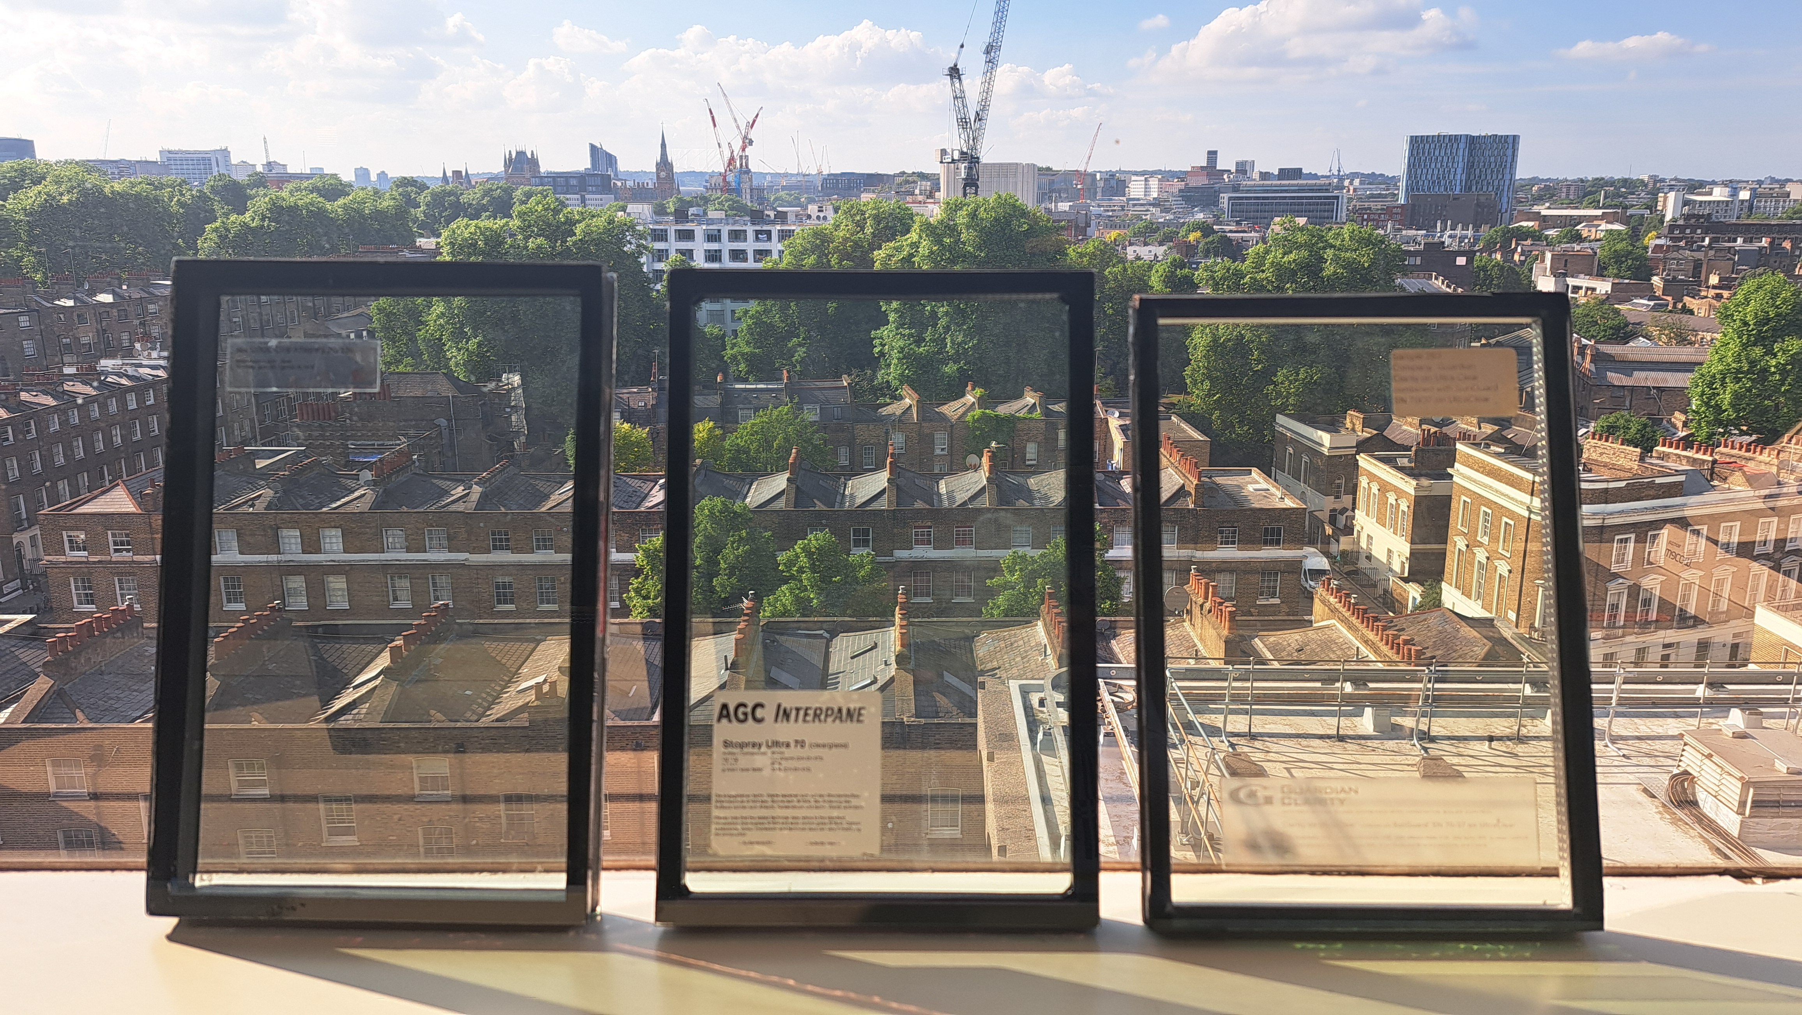
Glass Coatings
Performance comparison
COATING PRODUCT | SUNGUARD SN 70/35 | STOPRAY ULTRASELECT 70/33 | COOL-LITE SKN 175 |  | TARGET
APPEARANCE
SUPPLIER | Guardian | AGC | Saint-Gobain |  | -
U-VALUE (W/m2K) | 1.0 | 1.0 | 1.0 * |  | ≤2.1
G-VALUE | 0.30 | 0.30 | 0.32 |  | ≤0.40
LIGHT TRANSMITTANCE (%) | 62% | 67% | 68% |  | ≥40%
EXTERNAL REFLECTANCE (%) | 12 | 10 | 14 |  | -
Place holder
Place holder
Place holder
* - Saint-Gobain’s configurator does not allow modelling 3 ply build-ups, performance changes would be minimal due to this.

Slide 23
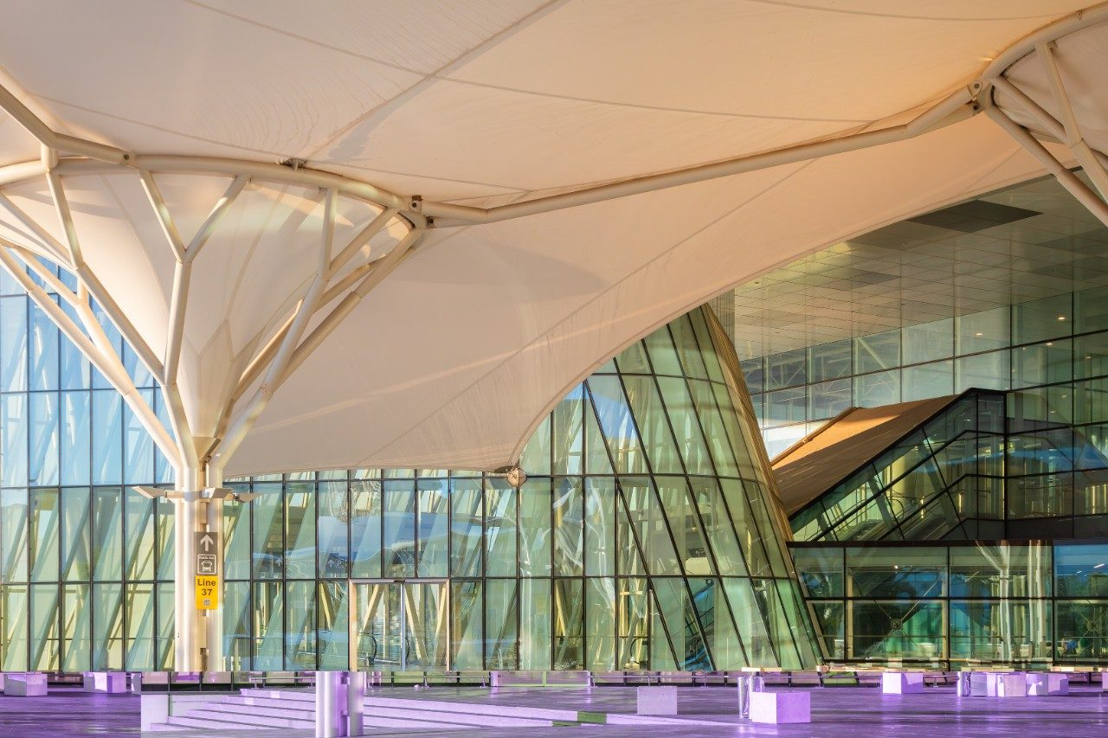
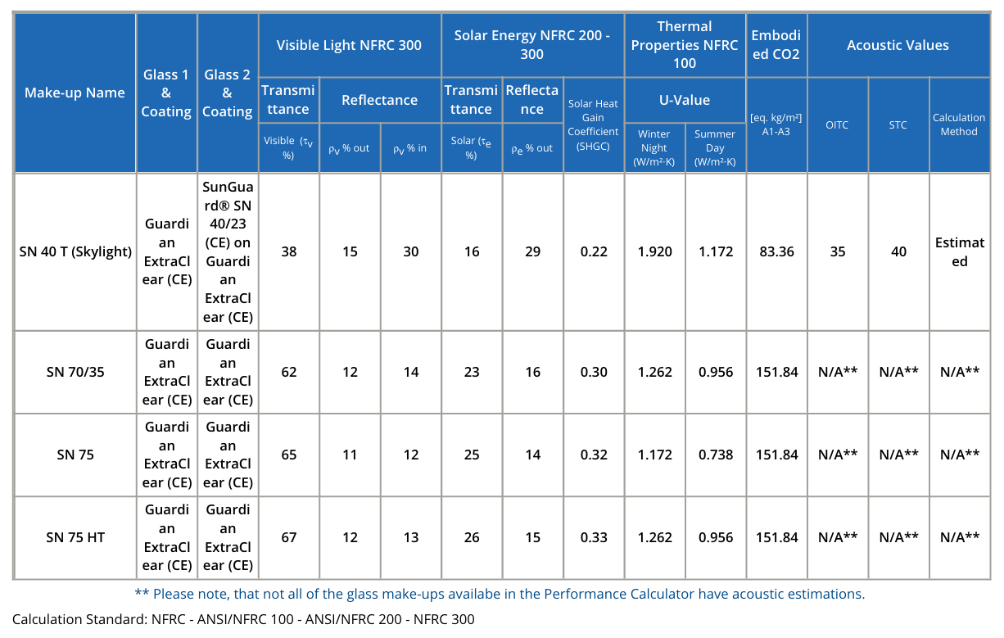
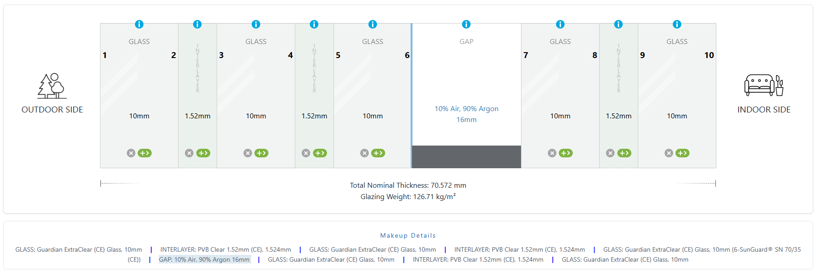
Project specific buildup
Guardian SN 70/35
Glass manufacturer: Guardian
LT: 62%
SHGC: 0.30
Aerodrom Split, Croatia

Slide 24
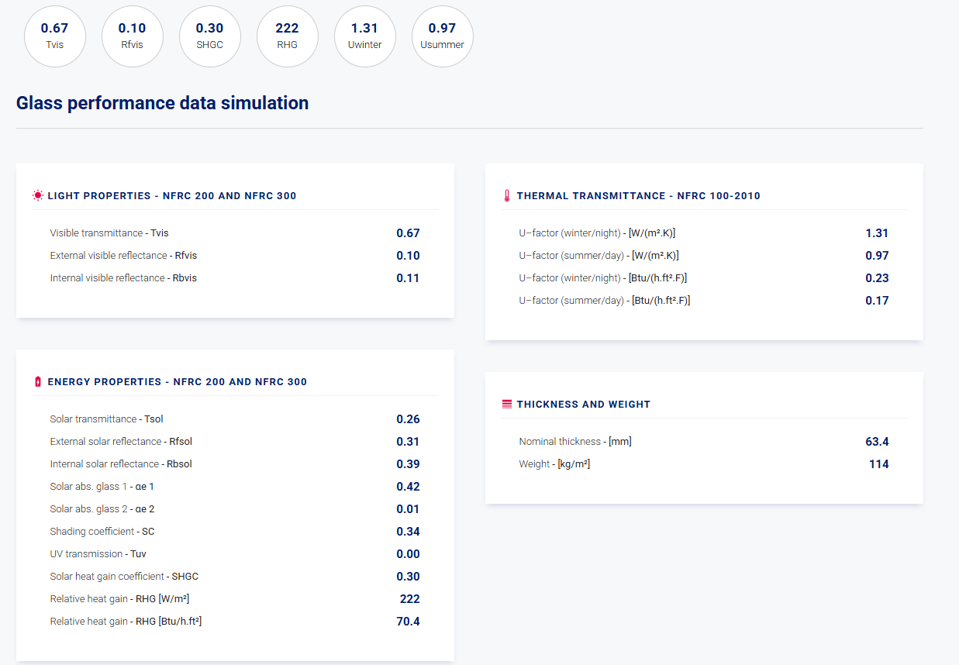
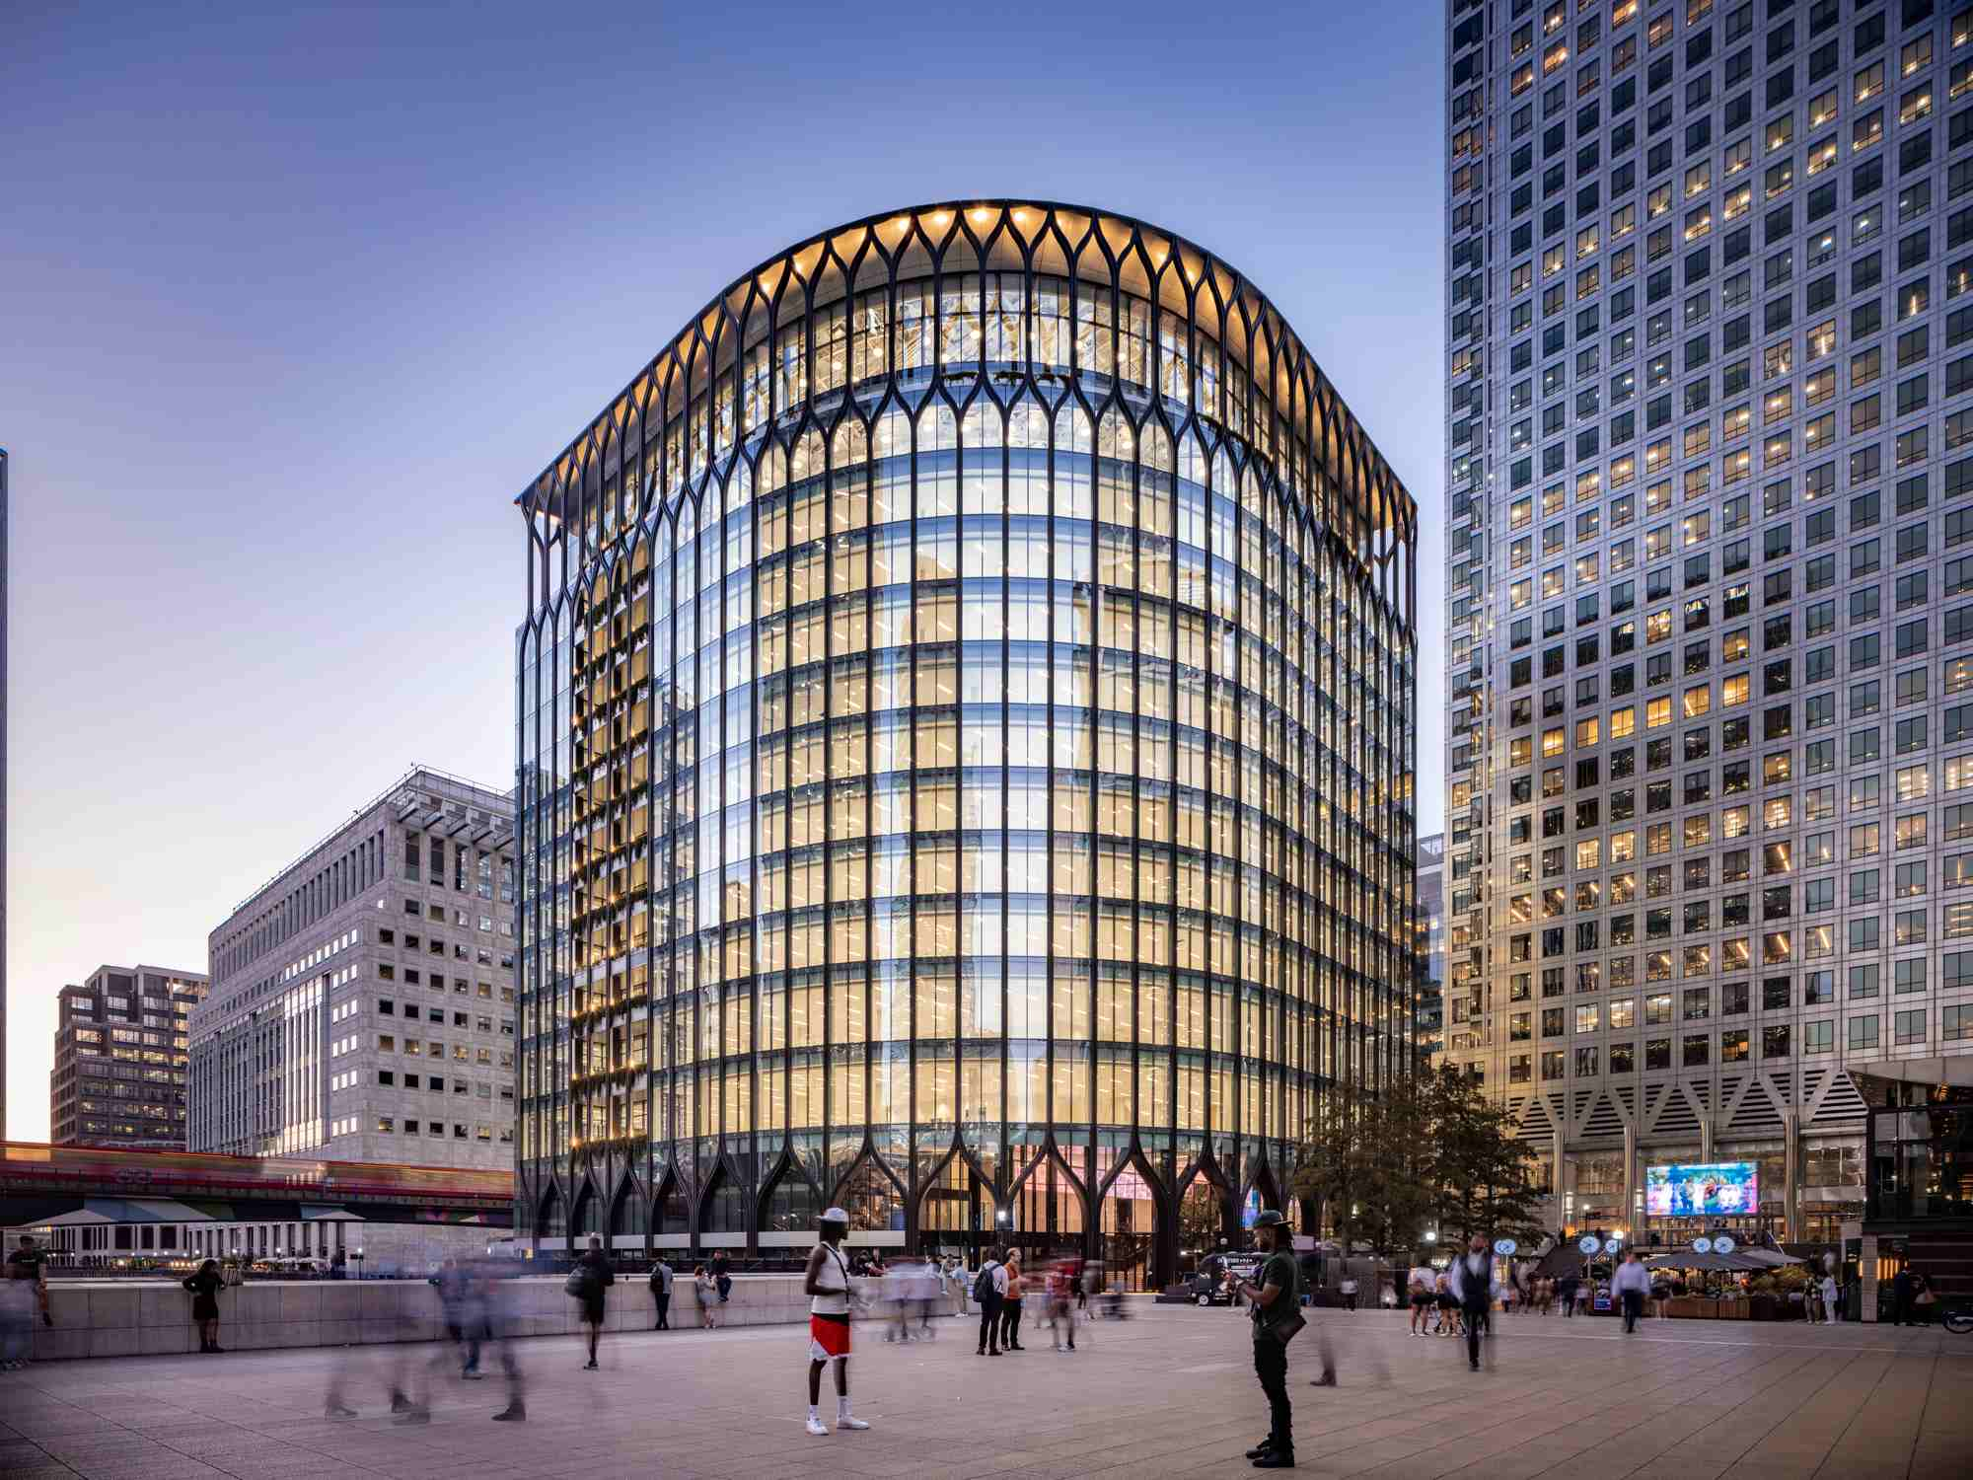
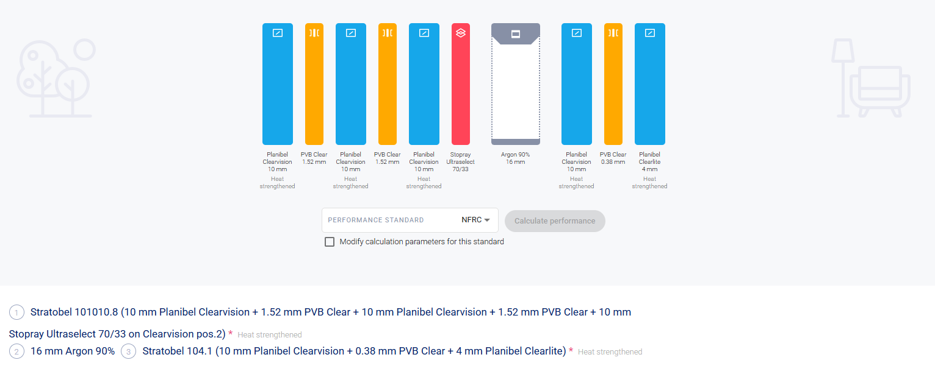
Project specific buildup
AGC Stopray Ultraselect 70/33 on Clearvision
Glass manufacturer: AGC
LT: 67%
SHGC: 0.30
YY Building - London

Slide 25
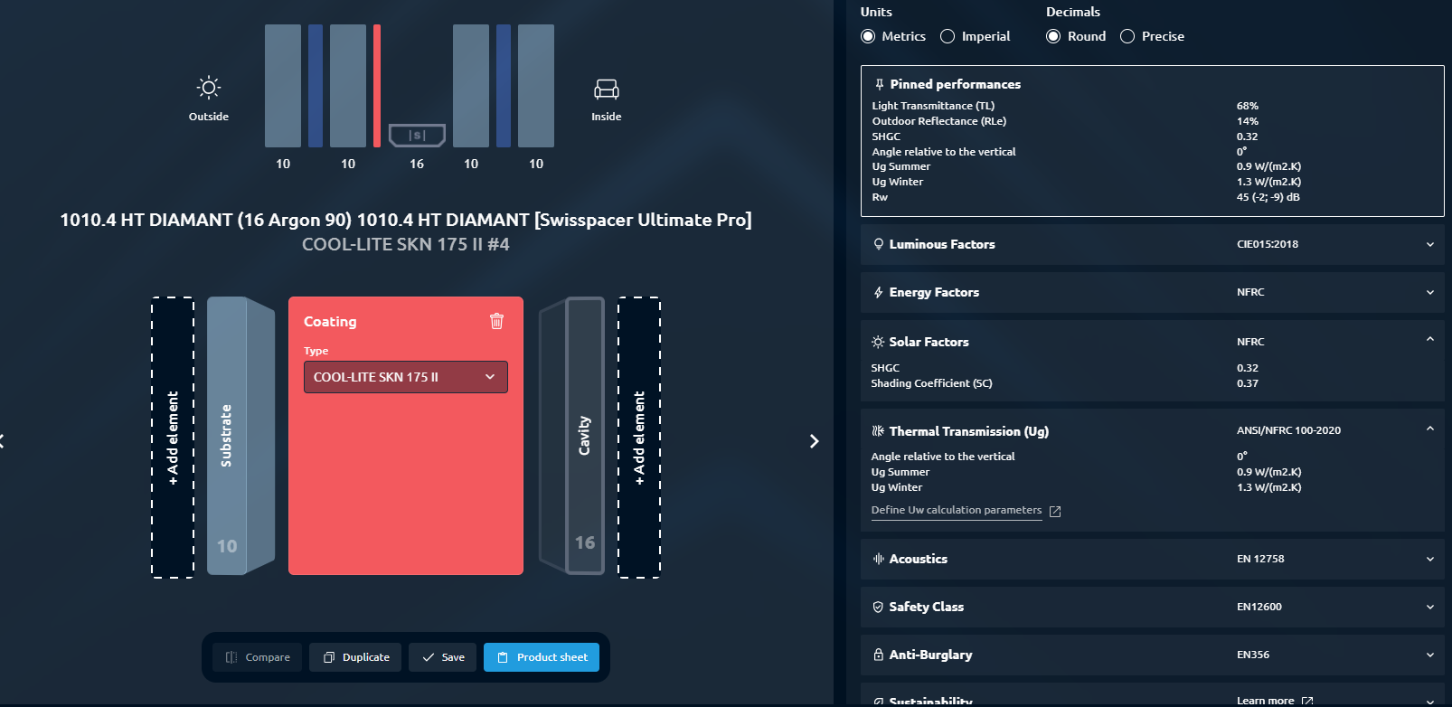
Project specific buildup
Saint-Gobain COOL-LITE XTREME 70-33
Glass manufacturer: Saint-Gobain
LT: 68%
SHGC: 0.32
Place holder
YY Building - London
Saint-Gobain’s configurator does not allow modelling 3 ply build-ups, performance changes would be minimal due to this.

Slide 26
Thank you.
@eocengineers
Notes:
Choose one closing slide and delete the others as required.

